Slide 1
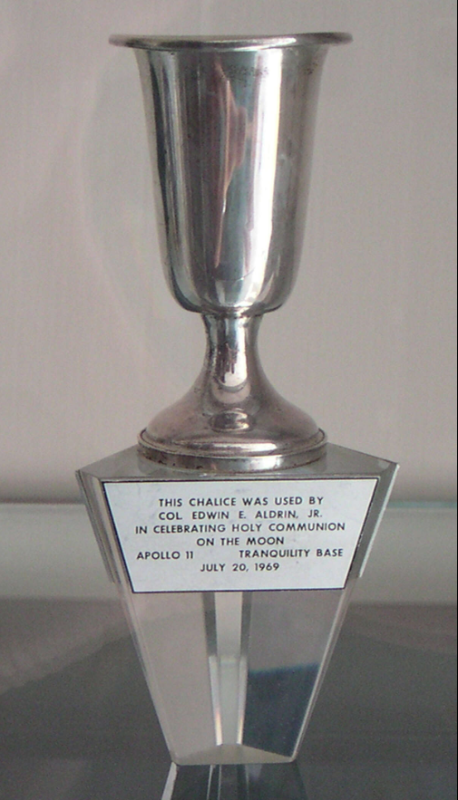
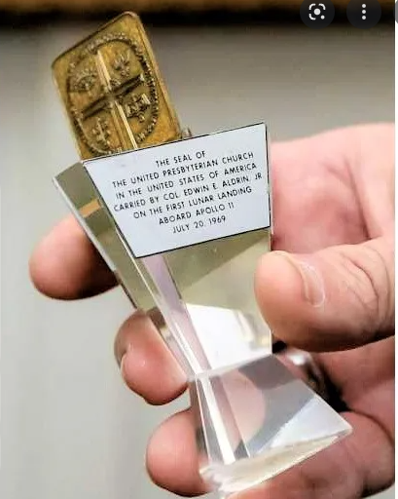
Exploring option to loan Lunar Chalice & Church Seal to Museum of the Bible
Tonight’s purpose
Provide an Updated status
Seek approval/funding to pursue a formal appraisal of items (Chalice & Seal)
Solicit Questions/thoughts – reinitiate discussion
Prepare for a possible October Session vote whether to loan out the items next year
Pictures from the web, the left from a Houston Chronicle article in 2014
We are reviewing others and considering having new ones made

Slide 2
Why Consider a Loan
Webster Presbyterian Church is an evolving spiritual community joyfully serving Christ as active disciples. We welcome ALL alongside us to create a more loving, affirming, just and sustainable world, valuing spiritual inquiry, civility of discourse, scientific ideas, and artistic expression. (WPC mission statement)
“serving Christ as active disciples” –
we are called to share that which we have with the world, not to hide it away, but to reach out and inspire all
“We welcome ALL alongside us” –
not all people or even all Christians share our views, we even differ in our own community, however this loan can be a way to welcome ALL alongside us
“valuing … civility of discourse” –
this is a way to reach out to the sponsors and the visitors to the Museum of the Bible, to encourage such respectable dialog
“valuing spiritual inquiry, scientific ideas and artistic expression” –
The Apollo 11 mission and its intersection with our own cherished communion is a great example of the pursuit of spiritual inquiry and scientific ideas, along with the potential to be presented in an artistic way

Slide 3
Intro & history
Started with 2016 dialog with Smithsonian – to support 50th anniversary display
They decided not to display religious artifact, referred us to Museum of the Bible (MOTB)
Prior Session Committee formed to explore idea of a Chalice & Seal loan – lead by Allen Brown
Interrupted by Covid – now considering loan in Jan 2023
New ad hoc committee formed to resume exploration of loan
  - Diane Kane, Jamee Wilson, Mary Lawrence, Al Strahan – Allen Brown consulting
NO commitment or recommendation has yet been made – Ultimately a Session decision
Request from the MOTB
Chalice to be featured in exhibit ‘Scripture & Science: Our Universe, Ourselves and Our Place’
Exhibit open from Jan 2023 to Jan 2024
55+ items including:
  Papers/notes by Galileo, Augustine, Kepler, Copernicus, Galenos, Dante & others discussing religious or scientific ideas (or both)
  Art including Greg Dunn (neuro art), Hippocampus drawings & a replica of the Statue of Asklepios (from Rome), Genome drawings, Leper terracotta (from Athens)
  Bibles from Dorothy Vaughn (Hidden Figures) & Francis Collins (Genome researcher)
  An early copy of “A Letter from Birmingham City Jail” (Martin Luther King)
  Scientific instruments including Astronomical Quadrant, microscope (Santiago Ramon), early sketches of the Babbage analytic engine
Lenders include: Austrian National Library, Capitoline Museum Rome, Children’s Museum Indianapolis, Harvard, Princeton, History Nebraska, University of Oklahoma, Laurentian Library Florence, National Archeological Museum Athens, National Central Library Florence, Vatican Observatory, various private individuals and institutes

Slide 4
We are in discussion with Daved Anthony Schmidt, Head of Collections and Curation
  professional, PhD in history, Presbyterian background
Chalice and Seal would be displayed together in a secure glass case
He is proposing text on placards as follows, though he is open to edits or suggestions
Pod 5. Primary 1 (Anchor Story)
“One Giant Leap for Mankind”
With one small step, humanity accomplished the dream of standing on another world.
On July 20, 1969, Apollo 11 astronauts Neil Armstrong and Edwin Eugene “Buzz” Aldrin landed on the moon, becoming the first humans to do so, less than 70 years after humans first took flight.
The moon landing had involved thousands of people, with millions watching across the globe. For some, such as Aldrin, this epic journey was significant for his faith. Before leaving the moon’s surface, Aldrin celebrated communion.
[Graphic Text:]
“I am the vine; you are the branches. Whoever abides in me and I in him, he it is that bears much fruit, for apart from me you can do nothing.” John 15:5
[Graphic Text:]
“Apollo first placed human feet on a planet other than earth. . . . It is a symbol of humans reaching outward—a symbol of the human spirit. Yet, it was not accomplished by human endeavor alone. It was strengthened with the spirit of God within those who accomplished it.” Dick Koos, Apollo Flight Simulation Supervisor, 1993
[Secondary Panel A:]
Lunar Lord’s Supper
Aldrin taught Sunday School and served as an elder at Webster Presbyterian Church outside of Houston, Texas. He devised his plan to take communion on the moon with Webster’s pastor Dean Woodruff, who secured a chalice small enough to carry aboard the spacecraft.
For Aldrin, communion was a principal symbol of faith. God revealed himself in the bread and wine, common products of human labor. According to Aldrin, “I wondered if it might be possible to take communion on the moon, symbolizing the thought that God was revealing Himself there, too, as man reached out into the universe. For there are many of us in the NASA program who do trust that what we were doing is part of God’s eternal plan for man.”
Aldrin read John 15:5, which he had printed on a notecard, before taking communion. The bread and wine he consumed became the first liquid ever poured, and the first food eaten, on another planetary body.

Slide 5
Some more details – timeline and loan agreement
‘Soft’ opening to VIPs on Jan 19, 2023; open to public the following day
  Rumors Aldrin might attend, though we have not been able to confirm
Need to have Chalice and Seal by Jan 10, 2023 for a 1 year loan
A commitment in the late October timeframe would best support this schedule
  Ideally, this would be a Formal Session vote in October
  need a vote of all Session members, not just a minimal quorum
We have a draft copy of the Loan Agreement (will be available on Session website) includes:
  Defines loan items (will include images)
  Care and Handling instructions (including option for us to mandate additional requests)
  Mishap instructions (standard) – including to immediately contact us & attempt no repairs
  Insurance – they will insure to a price we agree upon, informed by an appraisal
    To be delivered 30 days prior to receipt of loan item (i.e Dec 10)
  Return item only to us (Webster Presbyterian)
    More specifically, we can define this as Clerk of Session or someone comparable
  Warranty of Title
    We declare ourselves as owner, as acknowledged by MOTB
    If any other claims are made, we will be informed and offered right to contest
  Photography – MOTB has right to take photos for research and publication (publicity)
    Copies of publication to be provided to us when possible
Loan agreement reviewed/edited by Charlie Ward, Lawyer friend of WPC

Slide 6
Logistics/security
We have received and reviewed a Facility report for the MOTB
  A standard assessment of security for most major US museums
  MOTB capabilities appear impressive
    Large well trained 24 hour security staff, to include proximity to exhibit
    Sophisticated alarm systems and secure access points, etc
MOTB houses thousands of artifacts
  arranged 91 loans of 400+ items last year – much experience with transport and security
Shipping/protection
  they offer secure ‘white glove’ service where they transport to/from WPC
  or courier option where we accompany
  either at MOTB expense – we may lean towards first option
Appraisal
  Will inform our insurance requests, and is of future value for WPC (future loans, etc)
  Explored with various groups including Presbyterian Historical Foundation
  Identified Allan Stypeck (Washington DC appraiser who specializes in rare items)
  He is well familiar with items and history and will work over zoom
  Call will be open to any session member – being scheduled next week or so
  Hard to price such an item, more to incentivize protection
    We will request an appraisal for both items individually
    Some folks thinking at least $ 10,000,000 total
  Cost for appraisal - $ 300 - would like to request Session approve and fund this activity

Slide 7
WPC Thoughts/opinions
Our committee position
  We have not formally come to a consensus yet
  Some lean in favor, others more hesitant
  Generally becoming ‘more comfortable’ with the idea
  Will provide with our recommendation next month
Others in church
  Have talked this informally with various groups (covenant, bible studies, etc)
  Focusing on ‘older’ folks – the Apollo generation who have real memories
  Some hesitancy regarding risk of loss or MOTB views
    The Celtic Cross Gerald Carr flew on Skylab disappeared some years back – that still hurts
    The MOTB has been associated with evangelical and more right leaning views
  Still we are hearing more and more folks want to share our story, while we still have living memories to connect with it
  We will attempt to meet with some members at the Crossing within the next week – the Apollo generation
There is also a desire to discuss the long term future of these items regardless of whether we pursue an MOTB loan

Slide 8
What in work/what next
We will continue with efforts towards an appraisal (assuming approval), photography, and further informal discussions with WPC members
What we ask of Session
Fund an appraisal
Motion to approve spending $ 300 to secure a formal appraisal of the WPC Communion Chalice and Presbyterian Seal that flew to the moon and returned on Apollo 11. Purpose of appraisal is to inform an insurance agreement in support of a possible future loan of said items to the Museum of the Bible, and for future general reference and knowledge of the Session and congregation of Webster Presbyterian Church
Consider a 2023 loan to the Museum of the Bible
Please thoughtfully contemplate and pray on a forthcoming proposal, to loan the Apollo 11 Chalice and Presbyterian Seal to the MOTB, where we hope to conduct a formal discussion and vote at the October Session
Any additional thoughts/questions ?

