Slide 1
WEBSTER PRESBYTERIAN CHURCH
2015 Budget Planning
Jimmy Spivey
Treasurer
September 23, 2014

Slide 2
Proposed 2015 Budget Summary
2013 Budget was $669,372.00
2014 Budget is $674,736.00
2015 Proposed Budget is $758,976.90
  Increase of $84,240.88 ( 12.5%)

Slide 3
2015 Proposed Budget Increase Summary by Committee
Admin/Personnel - $57,375.68 ( 14.61% ) Increase
  Staff raises, Head of Staff Salary, Pastor Search - ~5K increase.
  Campus Management - $7,009.00 (7.92%) Increase
    Repairs and maintenance increase
  Communications – 3%
  Mission - $5,000.00 (12.50% ) Increase
Outreach - $1,710.00 (57.00% ) Increase
  Little Free Library, Water bottles, Public Announcements for New Head of staff
Worship/Music - $2,240.00 (20.95% ) Increase
  Added AV maintenance back
Other misc increases of $1000.00

Slide 4
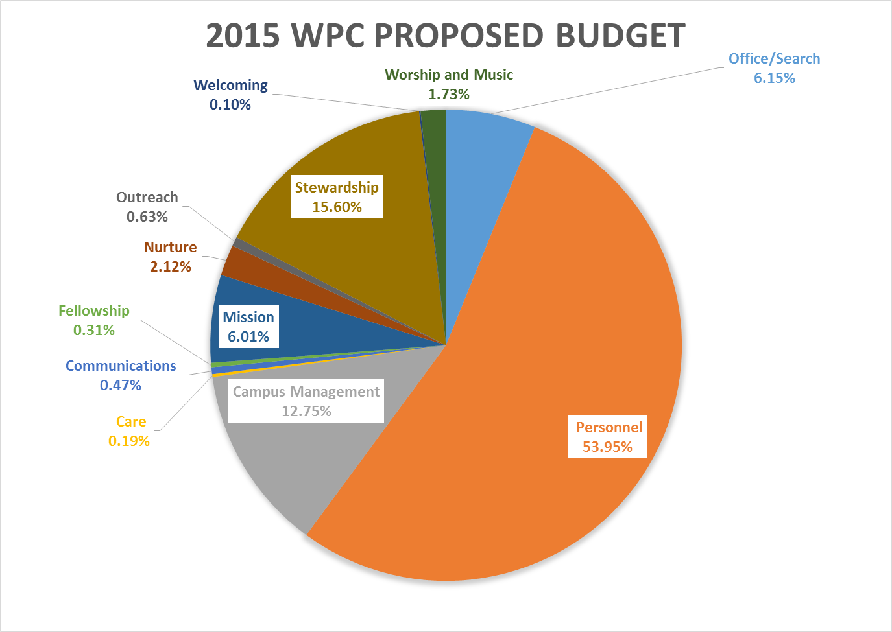

Slide 5
Other Changes
For those of you who submitted changes to budget line item descriptions (additions/deletions/moves), I have those changes captured, but the operating budget will not change until January ‘15.

Slide 6
Past Revenues/Expenses
 | Revenue | Expenses
2013 | 646,726.07 | 656,609.29
2012 | 693,720.54 | 643,826.03
2011 | 731,722.52 | 742,508.65
2010 | 772,181.10 | 759,152.23
2014 Budget is $674,736.00
2015 Proposed is 758,976.90
2014 Projected EOY revenue is 645,000.
  Projection is based on 2014 YTD 404,429.58 plus average plus rollthru. (conservative).

Slide 7
Next Step(s)
Agree to proceed to Stewardship activities highlighting the goals of next year. Which include a new Head of Staff.
  Emphasis on pledging
Or try to reduce proposed budget to come closer to recent years revenues.
  We will have a pledge total to help bound the revenue in December.

