Slide 1
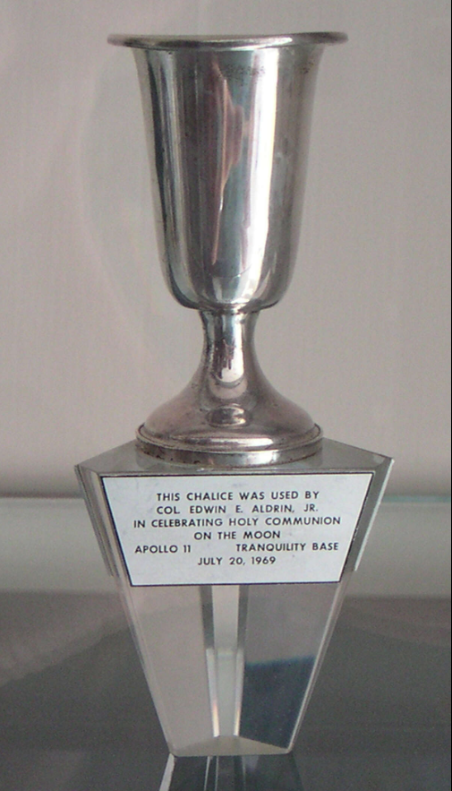
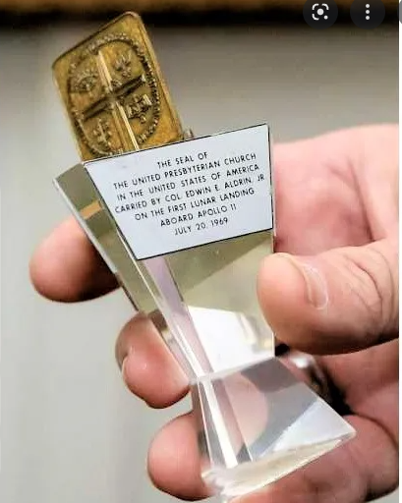
Proposal to loan Lunar Chalice & Church Seal to Museum of the Bible (MOTB)
(new material starts on page 5)
Pictures from the web, the left from a Houston Chronicle article in 2014

Slide 2
Why Consider a Loan
Webster Presbyterian Church is an evolving spiritual community joyfully serving Christ as active disciples. We welcome ALL alongside us to create a more loving, affirming, just and sustainable world, valuing spiritual inquiry, civility of discourse, scientific ideas, and artistic expression. (WPC mission statement)
“serving Christ as active disciples” –
we are called to share that which we have with the world, not to hide it away, but to reach out and inspire all
“We welcome ALL alongside us” –
not all people or even all Christians share our views, we even differ in our own community, however this loan can be a way to welcome ALL alongside us
“valuing … civility of discourse” –
this is a way to reach out to the sponsors and the visitors to the Museum of the Bible, to encourage such respectable dialog
“valuing spiritual inquiry, scientific ideas and artistic expression” –
The Apollo 11 mission and its intersection with our own cherished communion is a great example of the pursuit of spiritual inquiry and scientific ideas, along with the potential to be presented in an artistic way

Slide 3
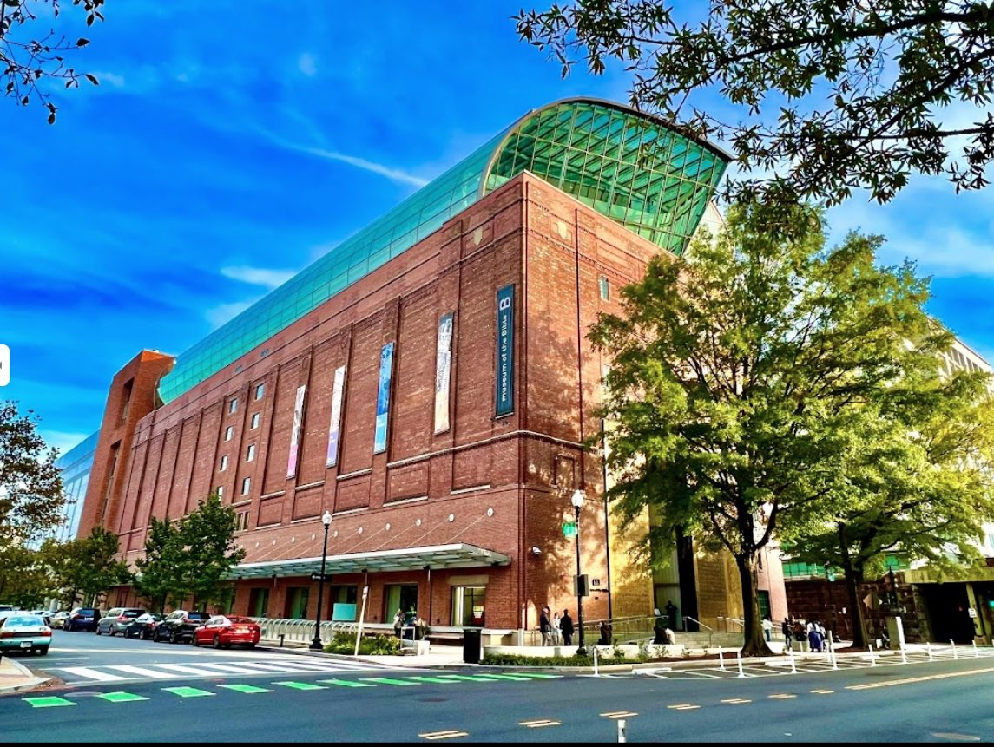
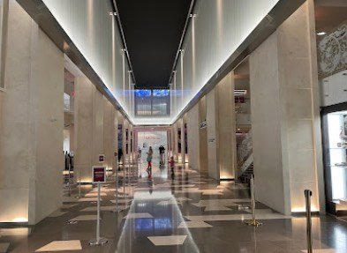
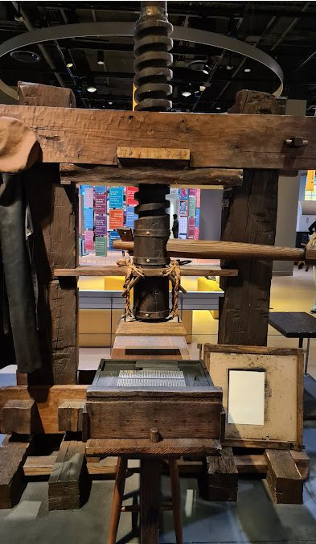
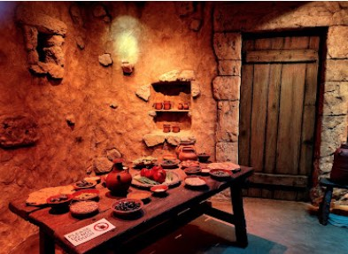
Background
Ad hoc committee explored proposal for a loan
  Diane Kane, Jamee Wilson, Mary Lawrence, Al Strahan – Allen Brown consulting
Chalice to be featured in exhibit ‘Scripture & Science: Our Universe, Ourselves and Our Place’
Exhibit open from Jan 2023 to Jan 2024, curated by Anthony Schmidt (PhD History), Presbyterian background
55+ items including:
  Papers/notes by Galileo, Augustine, Kepler, Copernicus, Galenos, Dante & others
  Art including Greg Dunn (neuro art), Hippocampus and Genome drawings & others
  Bibles from Dorothy Vaughn (Hidden Figures) & Francis Collins (Genome researcher)
  Astronomical Quadrant, an early microscope, a Babbage engine sketch & others
  Lenders include museums, universities across North America & Europe and the Vatican
2 blocks south of Air & Space Museum in DC
https://www.museumofthebible.org/

Slide 4
Some feedback
Ultimately a Session decision – though sought inputs from congregation members, especially the Apollo generation. Consulted with
  Members of Covenant Groups
  Bible Studies
  Residents of The Crossing
Some hesitancy regarding risk of loss
Still we are hearing more and more folks want to share our story, while we still have living memories to connect with it
There is also a desire to discuss the long term future of these items regardless of whether we pursue an MOTB loan

Slide 5
Appraisal and Loan Agreement
Initial Appraised Value by Allan Stypeck, expert appraiser for both historic and religious artifacts
  Has worked with collections for Henry Kissinger, Pope John Paul II, Catholic Church, NASA, etc
MOTB has verbally agreed to insure for these amounts
  Lunar Chalice: 2 million
  UPCUSA Presbyterian Seal: 500 k
Allan expects their value to increase with public awareness and interest
We are pursuing modifications to the Formal Loan Agreement - Anthony Schmidt has agreed to all in principle
  Agreement will include these values and a clause allowing for a re-appraisal after some time
  A clause that if ownership is contested, we will be informed and allowed opportunity to defend
    We don’t expect such
    Allan and others indicate we have clear provenance from historical record
    Agreement also states to return only to WPC
  A clause to not develop any merchandizing or use of Chalice likeness without our consent
  Two Lawyers, plus Allan Stypeck, have reviewed agreement
After consultation with Stypeck, we are leaning towards recommending ’White Glove’ transport
  Secure transport, door-to-door, where we would not accompany
  MOTB arranged safe/secure transport for 91 loans covering 400+ artifacts last year

Slide 6
Pros
Speaks to several points in our mission statement
  Being Active Disciples, welcoming all, having civility of discourse, exploring science & art…
Shares our story, our values and our history with many
  Many of the Apollo Generation would like now to share our story, while they are still alive
  Items not always locked/hidden in a vault
  There is renewed interest in Lunar exploration – NASA Project Artemis (hopefully flies before Jan)
Could generate interest/awareness in our church
  Possibly attract new members
Motivate us to generate a longer term strategy for where to go with these items
  We could do this even without following through on the loan
Cons
Regardless of our best efforts, the is a risk the items could be lost or stolen
  MOTB has a good security record - Still, there are nefarious actors who target such unique items
  Whenever valuable items are moved, they are most vulnerable
  If we are to loan items, we must accept some non-zero risk we will not see them again
While majority appear supportive, there are a few congregants who oppose this loan
  Still others who support it are generally nervous about loss
New attention will likely require increased security
  We should consider budgeting insurance in the future (15-20 k per year or more)
  We may need additional security to transport and display items for Lunar Communion
  Is our current storage location secure enough ?
  Who do we arrange to have access in the future ?

Slide 7
Pro & Con
Loan requests could come from other museums/organizations
  We recommend a Session committee review/negotiate each request on an individual basis
    We don’t always have to loan for a year, even if we do this time
  Perhaps consider a desired loan interval (example only loan out 25 % of the time)
This could generate more attention than we are ready for
  It has been suggested we designate a person to support interview requests
  Also suggested we prepare a ‘throw down’ press-release/statement available upon request
  Perhaps also a new heading on our website
The Future
We should have a follow-up committee explore these questions
  Future security, insurance and who has access
  How share with the world – what story do we want to tell going forward
Also consider how care for these long term – hundreds of years and more
  Items are tarnished
    MOTB fine with this though willing to provide a professional assessment and advice
    Loan agreement prevents any effort to alter or even clean items without our approval
  Description plates have scuff marks
    They did not travel to moon, though still looks bad
    Consider better more protective handling and storage protocols
  Don’t believe we should remove dents, though we should endeavor to prevent more

Slide 8
Motion background
Remaining work
  Still finalizing MOTB Loan Agreement
    We do not anticipate issue, however we are not ready to sign today
    We would like another Lawyer review, then a final review with the MOTB
    Anticipate this lasting another 2 – 3 weeks
    Also, who signs for WPC, Clerk of Session ?
  Would like to pursue one more round of security discussions
    Expand on specifics of transport – perhaps codify more specifics in Loan Agreement
    One more review of MOTB on site access and security
In order to support MOTB exhibition schedule (opens Jan 19th), the MOTB would like an agreement ‘in principle’ that WPC Session supports the Loan of the Lunar Chalice and Seal to the MOTB, understanding there is still final negotiations on the agreement and security
  This allows them to proceed with preparation, though still with some risk that we don’t sign
  Also allows for specifics of secure transport and insurance acquisition to start

Slide 9
MOTION
We, the Webster Presbyterian Church (WPC) Session, support a temporary loan to the Museum of the Bible (MOTB) in Washington DC, the following church artifacts pending the negotiation of a secure loan agreement:
1) Lunar Communion Chalice used by Edwin ‘Buzz’ Aldrin to celebrate Communion
2) UPCUSA Church Seal
Both being WPC property that travelled to the Surface of the Moon and the Sea of Tranquility on July 20, 1969, and were returned to the possession of WPC after the flight.
The loan period being from Jan 2023 to Jan 2024, to support and be displayed in a curated exhibit exploring Scripture and Science.
This motion is contingent upon the MOTB covering the full cost of insurance for these two items during the entire time they are not in possession by the WPC, including transport to and from the Museum.
This motion also is contingent upon determination that a satisfactory Loan Agreement and security arrangements are in place with the MOTB.
(end of motion)

