Slide 1
WEBSTER PRESBYTERIAN CHURCH
2018 Challenge Budget
Jimmy Spivey
Treasurer
11-20-17

Slide 2
2018 Budget Summary
2016 Budget was $660,651.17
2017 Budget is $634,000.00
2018 Proposed Budget is $669,604.26
  Increase of $35,604.26 ( 5.6%) from 2017 to 2018.

Slide 3
Past Revenues/Expenses
2017 giving thru Oct is $531,770.60, avg $53,177.06. If we meet that average thru December, project $643,600.11
for 2017 giving.

Slide 4
2018 Proposed Budget Changes by Committee
Admin - $ 1,998.00 increase (Computer and postage actuals)
Personnel - $15,000 increase
  Staff raises (1.5 - 3%)
  Campus Management - $3,640.00 increase
    Repairs and maintenance slight increase
    Fire alarm cost increase
  Mission - $4,000.00 increase
Worship/Music - $20,400.00 increase
  Added Organ/piano maintenance back
  Choir scholarships
  Increase for special musicians
Stewardship - $9,000 decrease
  Uses discount achieve by an extensive facility review last month

Slide 5
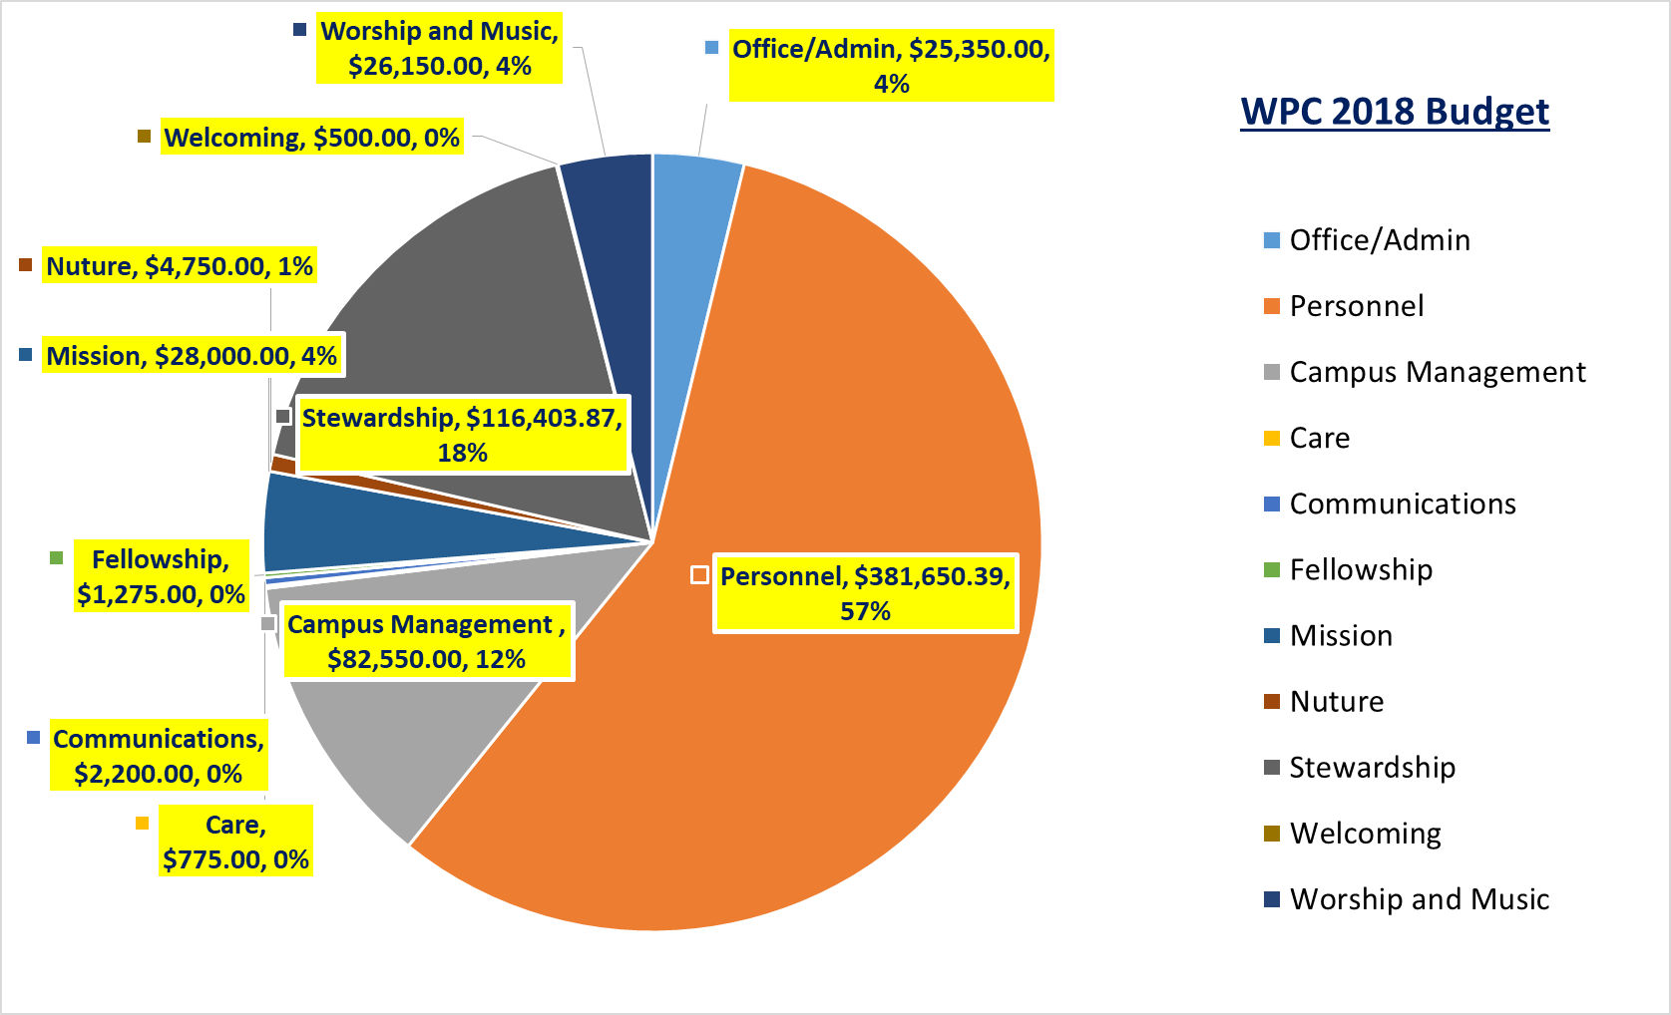

Slide 6
Other Changes
Reminder those of you who want changes to budget line item descriptions (additions/deletions/moves), those changes will be captured, but the operating budget will not change until January ‘18.

Slide 7
Next Step(s)
Stewardship
  Emphasis on pledging
Evaluate December pledge total to bound the revenue.
  Take the pledge and historical not pledge support and evaluate giving per the challenge budget
S&F will recommend budget in early Jan 2018 for session to prayfully consider and then approve.
Present Budget to Congregation in late Jan annual meeting (no vote by congregation)
  Congregation does vote to approve our amazing Pastors Terms of Call (TOC).

Slide 8
Luke 21: 1-4
Jesus looked up and saw the rich putting their gifts into the offering box, and he saw a poor widow put in two small copper coins. And He said, “Truly, I tell you, this poor widow has put in more than all of them. For they all contributed out of their abundance, but she out of her poverty put in all she had to live on.”

