Slide 1

The Technical Arts Ministry

Slide 2

The worship of God is a profound and sacred act of Christianity and has thrived for centuries. Corporate worship comes from our desire to publicly praise and thank our Lord Jesus Christ for his love and redemption. In this time of uncertainty and anxiety due to a silent but harmful enemy named Coronavirus Disease 2019, we continue to come together electronically as a corporate body, still one church through the Holy Spirit, but staying physically apart to preserve our health and life in honor of God.
From the WPC Vision Initiative Grant Application, 2020
Patty K. Eng

Slide 3
Webster Presbyterian Church Online
Prior to March 2020, WPC had been exploring the expansion of the church’s technology by investigating new sanctuary screens, video cameras, sound systems (sanctuary/fellowship hall), and other additions to enhance learning, worship, and sharing.
When the Texas Governor ordered a statewide shutdown effective March 20, 2020 due the Coronavirus, WPC accelerated the pace of technology advancement by offering recorded worship services posted online and using Zoom for all meetings.
Thus, Webster Presbyterian Church Online was born.

Slide 4
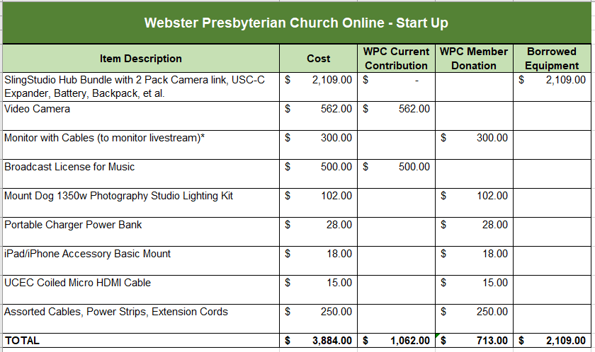
Webster Presbyterian Church Online:
What We Needed To Get Started,
Recap Spring 2020

Slide 5
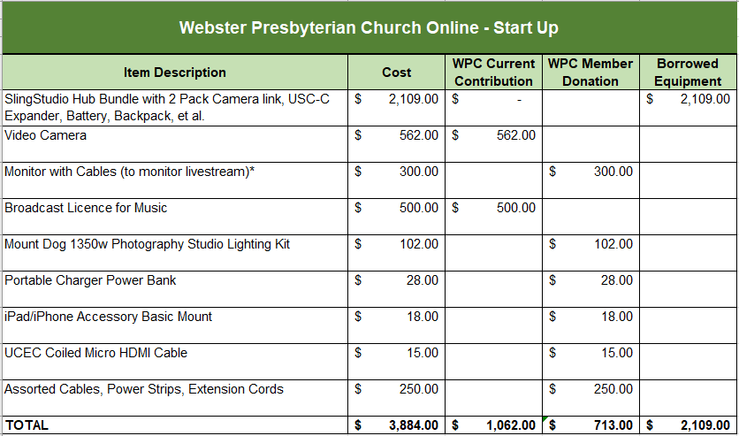
Webster Presbyterian Church Online:
What We Needed To Get Started: Recap Spring 2020
Church member purchased new. Request reimbursement in future?
WPC purchase
Church member donation.
WPC purchase. Budgeted item.
Church member donations.
Most items purchased new specifically for WPC Online.

Slide 6
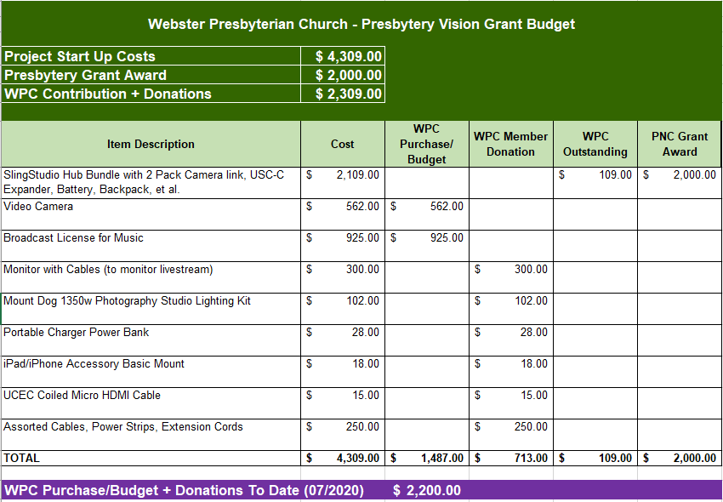
Along Came A Grant…
Presbytery of the New Covenant Visioning Grant Award: $2000 Matching Grant to WPC, June 2020
Presbytery Funds go toward SlingStudio.
Ready for reimbursement if award is in.
Church purchases. License amount adjusted for broadcast permissions.
Church member donations.
Most items purchased new specifically for WPC Online.

Slide 7
Webster Presbyterian Church Online
Status: July 2020
Pre-recorded services filmed one week in advance (Saturdays)
  Recorded (usually) in order with stops between each presenter or musician(s)
  Edited afterwards (smooth transitions, color, sound)
  Closed captioning, credits, and references added
  Weekly bulletin distributed via email and on the WPC Website
  Final recording posted on YouTube, WPC Website, and individual shares
WPC Online Team includes: WPC ministers, lay liturgists, music team, video/camera director, sound director, and youth techs
Finance Committee has added virtual giving methods for donations
YouTube has statistics to analyze viewer patterns

Slide 8
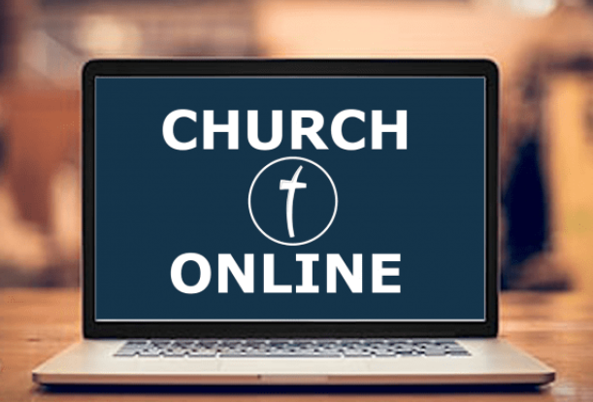
Webster Presbyterian Church Online
After the Building Reopens
Online ministry can continue to reach those who:
Cannot attend in person regularly or at all
Choose to worship only online (young adults, those who work Sundays, live too far)
Visitors searching for a church home
Visitors from other places who want to worship electronically with us

Slide 9
Webster Presbyterian Church Online
After the Building Reopens
Online Ministry Can Be Used to:
Broadcast & record special events anywhere on the church campus: ArtTalks, Installations, Guest Speakers, & Special Music (license permitting)
Record off-campus events: Outdoor Worship Services, Interfaith Gatherings, Family Picnics, & Shrimp Boil (WiFi permitting)
Broadcast & record meetings: Presbytery (on and off-site), Disaster Recovery, & Pandemic Updates

Slide 10

Webster Presbyterian Church Online
What’s First?
In addition to disinfecting and other protective measures, churches have to block off every other pew, observe social distancing, require masks, and eliminate paper: Bibles, hymnals, bulletins, and pew cards. (In process)
This means that WPC Worship will rely viewing worship on screens or LED monitors. Not all the projectors in our sanctuary are currently working. This has to be fixed before the sanctuary could reopen.
What are the options?

Slide 11
Church Screen Options
“Whether your sanctuary seats 50 or 5000, the basics of video display are the same: your objective is to take a signal from a source and put it in a place that everyone can clearly see.”
Andy McDonough, Church Production.

Slide 12
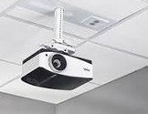
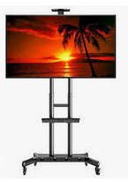
Church Screen Options
Replace the current projectors with new models.
Use current screens -- Equipment + Installation Cost: $7,000
Install new screens – Equipment + Installation Cost: $16,000
Pro: Proven technology that has been used in the past. New cameras are more durable and should last longer. Two companies have evaluated the sanctuary for this option and recommended this set-up.
Con: Not the newest technology. Would probably be replaced with other equipment in the near future. Difficult to get to for installation or repair.
Use 70” LED TV’s on rolling carts placed throughout the sanctuary.
Equipment + Installation Cost: $7,000.
Pro: Intermediate step toward changing screens. They can be used anywhere in the church. Easy to install and use. Easier to replace than projectors.
Con: Large sanctuary with social distancing means many screens on wheels. Not aesthetically appealing. Prevents people from looking forward during the service. Must be big enough to be seen by several rows of people. Not a permanent or long-term solution. Storage issues. Potential WiFi issues.
More

Slide 13
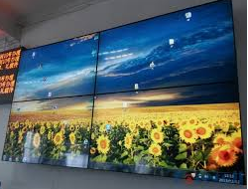

Church Screen Options
Install low(er) cost LED televisions on the walls.
OPTION 1: Install Smaller TV’s grouped together to make a big screen, aka Video Wall.
Equipment + Cabling + Installation Cost: $9,000
OPTION 2: Install 3 Larger TV’s (86”) in place of current screens.
Equipment + Cabling + Installation Cost: $7,000
Pro: Current technology with Smart TV/HD/LED capabilities as well as monitor screens for worship. Adds flexibility to viewing: order of worship, drop in videos, podcasts, broadcast shows, livestreaming. Low maintenance.
Con: The sanctuary has not been evaluated for this type of technology. Requires cabling, power, mounting, and other accessories to make it work. Screens smaller than 100” may be too small to be seen. These lower cost screens may not work as well as higher end ones: distorted images or angling issues. May have to replace them more frequently. Video Walls may be difficult to manage: one panel may fade before others and mounts can fail. Prior to any purchase, would need to work with technicians and installers to ensure proper equipment.

Slide 14
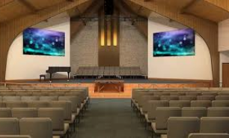
Church Screen Options
Install commercial grade display LED televisions on the walls.
Equipment + Cabling + Installation Cost: $30,000+
Pro: Current technology with Smart TV/HD/LED capabilities as well as monitor screens for worship. Adds flexibility to viewing: order of worship, drop in videos, podcasts, broadcast shows, livestreaming. Low maintenance post installation. Higher quality adds to longevity, brightness, reliability, better viewing angles, and larger display areas. Could fit in well with a long term vision plan for sanctuary remodeling or adaptations.
Con: Much higher cost. The sanctuary has not been evaluated for this type of technology. Requires cabling, power, mounting, and other accessories to make it work. Screens smaller than 100” may be too small to be seen. Prior to any purchase, would need to work with technicians and installers to ensure proper equipment.

Slide 15
Webster Presbyterian Church Online
What’s Next?
Short Term
Replace borrowed cameras, lights, and other equipment
Multiple cameras in the sanctuary for livestreaming and recording regular worship
Upgraded AV Booth including lap tops and monitors
Adding more equipment and personnel (paid & volunteer)
Making Sanctuary adaptations such as chancel lighting and platforms for cameras in back
Personal wireless microphones (no sharing, better sound, improved recording)
Editing software (easier to drop in other videos, add worship liturgy, speed up editing)
Testing with software, hardware, equipment, screens, and projectors
Long Term
Improved sound equipment in Sanctuary and Fellowship Hall
Video Monitors for the Narthex, Classrooms, and Fellowship Hall
Additional Sanctuary adaptions such as better lighting
Enhanced camera positioning and/or mounted cameras

Slide 16
Why Do We Want to Improve WPC Online
WPC has a unique message to share with the world: love, peace, forgiveness, inclusiveness, compassion, community involvement, and acknowledgement of science. Not all ministries promote these values and gifts.
Our special events can be recorded and preserved a greater a level for future watching using the excellence model: watchable and audible quality that promotes interest in involvement and not just perfunctory performance.
More people will watch a higher quality product.
WPC Online attracts younger people, those interested in technology, those who can’t attend
in person, or those who fear coming to church.
Continuing the online giving options gives WPC more options for collecting tithes and
offerings, especially to those who don’t come in person.
While WPC Online will never replace WPC in person, it gives people more opportunities to worship and participate from wherever they are physically, emotionally, mentally, and emotionally.

Slide 17
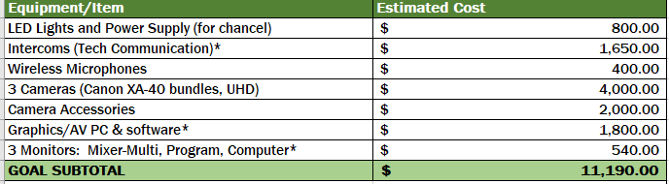
WPC Technical Arts Goals & Budget:
Sanctuary Reopen through Year 1
Goal 1 – Move technical equipment to the AV Booth and have less obtrusive lights and cameras up front.
Goal 2 – Replace borrowed equipment with church equipment.

Slide 18

WPC Technical Arts Goals & Budget:
Sanctuary Reopen through Year 1
Goal 3 – Livestream and record worship services and events.*

Slide 19

WPC Technical Arts Goals & Budget:
Sanctuary Reopen through Year 1
Goal 4 – Reduce editing time, add drop-ins easily,
& create content.

Slide 20

WPC Technical Arts Goals & Budget:
Sanctuary Reopen through Year 1
Goal 5 – Employ personnel to carry out media duties
and manage volunteers.

Slide 21
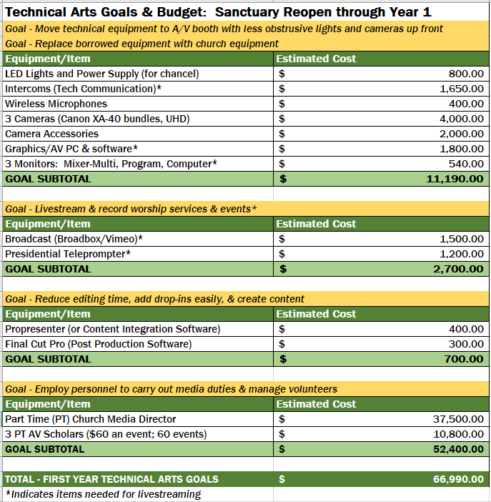
WPC Technical Arts Goals & Budget: Sanctuary Reopen through Year 1

Slide 22
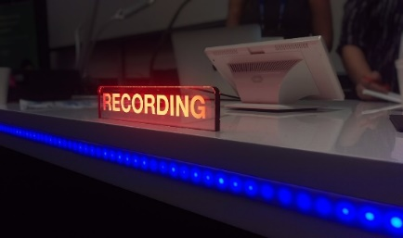
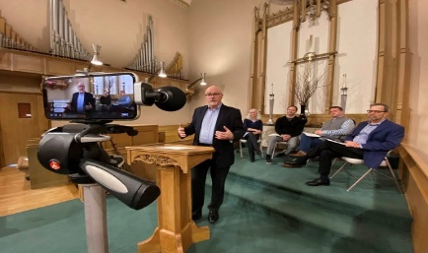
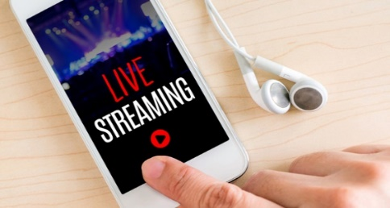
Recording vs. Livestreaming
(And why we’ll do both…)
Recording is making a record of an event. It isn’t necessarily broadcasted at that moment.
We build the WPC Online Service now by recording each segment in order. Then, it’s edited together into one event for broadcasting.
If a problem occurs during the recording, that section is filmed again.
Livestreaming means the event is broadcast live while it is happening.
There is no stopping or redoing. Mistakes or problems simply occur and are broadcast that way.
The livestream is sent to a social media site such as Facebook or other third party distributor.
We want to continue to record and edit (closed captioning, credits, church information, sound, lighting) for the permanent videos we make.
WPC Online would post all edited recordings on the church’s website and YouTube.
Offsite events could only be broadcast if the proper WiFi and connections are available, so most would only be recorded.

Slide 23
Many, Many Thanks to the
WPC Technical Artists:
Andy Eng
Dan Walker
Ross Looney
Dennis Waehner
India Allen
Garrett Allen
Sebastian Houg
Coco Motley
Patty Eng

