Slide 1
2026 Operating Budget Proposal
January 27, 2026 stated Session meeting
Webster Presbyterian Church

Slide 2
Goals for budget presentation
Final review of 2025 actual
Fuller understanding of the current financial position of the church
Basis for the current version of 2026 operating budget (26OB)
Discussion for modifications to the 26OB
Approval of 26OB for presentation to the congregation at called congregational meeting
Not reviewed at this meeting is analysis of 2025 giving to the restricted accounts

Slide 3
2025 end of year
2025 | Total income | Total expenses | EOY Balance
Plan | $585,001.00 | $599,790.00 | ($14,789.00)
Actual | $627,414.00 | $588,655.00 | $19,259.00 ^{*1}
^{*1} Discounting 2026 prepays:
$38,759 (accounting EOY balance) - $19,500 (prepays) = $19,259.00

Slide 4
Total giving to WPC in 2025
Fund | Contributions
Support | $573,691.00
Capital | $65,463.00
Choral Scholars | $10,610.00
Wycliffe Missionary Support | $18,074.00
All other funds | $47,456.00
 | Contributions
All funds for 2025 | $715,294.00

Slide 5
Few statistics for 2025
Giving units: 143
Average contribution: $3,536
Median contribution: $1,450

Slide 6
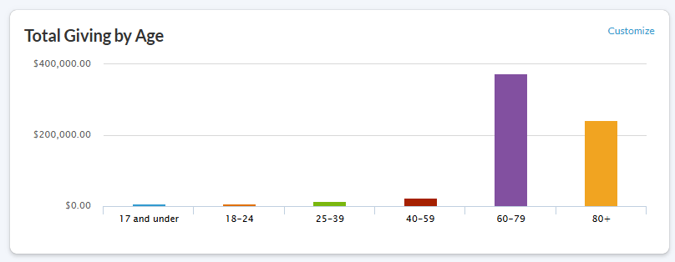
2025 giving to all funds

Slide 7
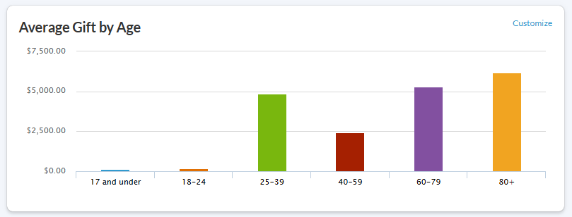
2025 giving to all funds

Slide 8
Transition to financial view of WPC

Slide 9
A good graph is better than numerous spreadsheets and data tables
Graph will be incorporated at least quarterly into the treasurer’s monthly report

Slide 11
Transition to 2026 Operating Budget

Slide 12
Pledges to 2026 funds as of January 26, 2026

Slide 13
2026 proposed operating budget (26OB)
Year | Total income | Total expenses | EOY Balance
2025 OB Plan | $585,001.00 | $599,790.00 | ($14,789.00)
2025 EOY Actual | $627,414.00 | $588,655.00 | $19,259.00
2026 OB | $577,500.00 | $641,352.00 | ($63,852.00)

Slide 14
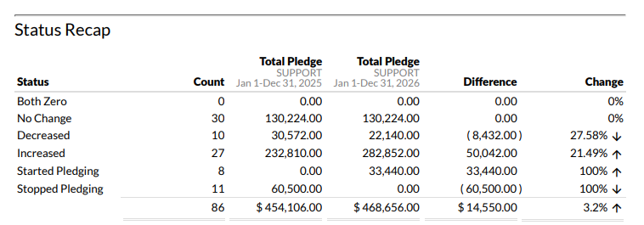
Impacts on the income side
Prepays are $15,000.00 less in 2026
Contributions from additions and subtractions due to membership changes are approximately flat year-to-year

Slide 15
Impacts on the expense side
Item | Estimated impact
Insurance premium increase | $38,000
Mission requests | $4,800
Support staff training option | $4,000
Changes in budget request options since last report:
Personnel removed pay raise request for staff
Personnel removed request to increase parish associate hours
Maintain insurance for the entire year
Choral scholars operating budget request offset by pledges to choral support fund

Slide 16
Options towards approving 26OB
Drop insurance coverage at some point in future
Search for better insurance rates
Consider
  Adding pay raises back in
  Increasing parish associate hours
Adopt the $64K deficit operating budget until such time as decision is made on insurance

Slide 17
Path forward
?

