Slide 1
WEBSTER PRESBYTERIAN CHURCH
2020 EOY Summary
&
2021 Budget Recommendation to Session by Finance Team
J. Spivey/Treasurer
January 26, 2021

Slide 2
2020 End of Year Summary
Income = $617,155.11
Outlays = $567,520.44
Net = $49,634.67
Budget was $630,000.00
  Spending was under budget by $62,479.56
  Giving was under by $12,844.89

Slide 3
2020 Budget Details
Areas that significantly underspent due to COVID-19 uncertainty
  Mission ($18,305.75)
  Campus Management ($24,293.26 )
  Worship & Music ($9,436.22)
Those 3 areas totaled $52, 035.23 of the $62,479.56 less than budgeted amount.

Slide 4
WPC Budget Summary
2016 Budget was $660,651.17
2017 Budget was $634,000.00
2018 Budget was $656,000.00
2019 Budget was $608,120.00
2020 Budget was $630,000.00
2018-2020 3yr giving Average is $624,690.21
The 2021 budget should not be set higher than the 3 yr giving average
2019 & 2020 Giving was 617K

Slide 5
Past Revenues/Expenses

Slide 6
2021 Budget Recommendation
S&F Committee voted to recommend a 2021 budget of $615,000.00 Rationale is as follows:
We have struggled the last 2 years to keep our operating account positive, we carry negative balances in given months throughout the year.
Only an aggressive asking communication has resulting in the operating account being positive for Nov/Dec and the year.
COVID-19 still puts us at some risk for income.
At 615k, it’s a giving number slightly under the giving for 2019 and 2020 (617k)
Personnel costs are lower this year due to a half year AP. If we return to a full staff in the future we will need to account for that and not have a large year to year increase.

Slide 7
2021 Budget Changes by Committee
Admin/Personnel - $~5200.00 decrease overall (AP half year savings)
Campus Management - $5100 decrease
  Utility decrease
  Maintenance decrease from 2020, but still increase from 2019 and Capital Campaign balance at 68k
Care – $500.00 increase
  Mental Health Counseling
Earth Care added – $300.00 increase

Slide 8
2021 Proposed Budget Changes by Committee
Mission - $10000.00 decrease
  Mission giving outside of operating account >50k
Nurture - $4800.00 decrease
  Set to 2020 actual
Stewardship & Finance – $9000.00 increase
  Insurance rates increase
Worship/Music - $4100.00 increase
  AV scholars added

Slide 9
2021 Budget Summary

Slide 10
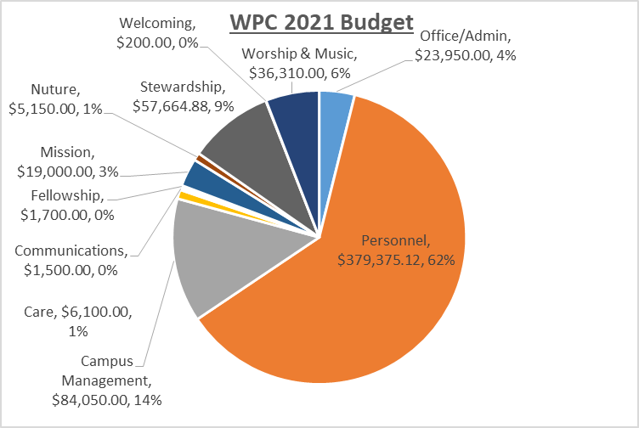

Slide 11
Vote
Motion from S&F Committee to set the 2021 WPC budget at $615,000.00

