Slide 1
WEBSTER PRESBYTERIAN CHURCH
2019 EOY Summary
&
2020 Budget Recommendation to Session
J. Spivey/Treasurer
January 28, 2020

Slide 2
2019 End of Year Summary
Income = $617,424.13
Outlays = $616,135.80
Net = $1,288.33
Budget was $608,120.00
  Spending was over budget by $8,015.80
  Giving was over by $9,304.13

Slide 3
2019 Budget Details
Areas that overspent budget
  Admin/Personnel ( $7301.32)
    Office –computer expenses, supplies, phone
    Pastors car allowance
    Secretary salary
    Family coordinator salary
    Nursery Staff
    Payroll expenses
  Campus Management ($4028.91)
    Maintenance, Janitorial, Lawn service
    Electricity was 3900 under
  Adult Ministry ($2386.04)
    Adult Ed
  Worship ($3259.88)
    AV maintenance
    Supplies (Apollo 11 50th celebration costs)

Slide 4
2019 Budget Details
Areas that significantly underspent
  Care ($1767.25)
  Mission ($650)
  Family Ministry ($1867.17)
  Music ($3513.04)
If those areas had spent the planned budget, 2019 would have been negative for the year by $6500

Slide 5
WPC Budget Summary
2016 Budget was $660,651.17
2017 Budget was $634,000.00
2018 Budget was $656,000.00
2019 Budget is $608,120.00
2017-2019 3yr giving Average is $639,896.38
The 2020 budget should not be set higher than the 3 yr giving average

Slide 6
Past Revenues/Expenses

Slide 7
2020 Budget Recommendation
S&F Committee voted to recommend a 2020 budget of $620,000.00 (527,144.00 pledged plus 92,856.00 unpledged). Rationale is as follows:
At 527k pledged, that is 20K more than actual 2019 pledged giving.
The pledged amount in 2020 includes families that have historically not pledged but gave regularly – thus the reduction in unpledged estimate.
We have struggled the last 2 years to keep our operating account positive, being negative for the year Sept- November for those months. Only an aggressive asking communication has resulting in the operating account being positive for December and the year. And we were only 1200 in surplus in 2019. Any slight expenditure increase this year would have caused us to be negative.
At 620k, it’s still an increase from 2019 and if keeping up in 2020, we can increase in 2021. And is slightly above the actual total 2019 giving.
Personnel costs are low this year due to a part time AP. If we return to a full staff in the future we will need to account for that and not have a large year to year increase.

Slide 8
2020 Budget Changes by Committee
Admin/Personnel - $5582.00 decrease overall (AP part time savings)
  Computer allowance and supplies increase
  Staff raises across the board - 3%
  Payroll expenses (PayChex service) increase
Campus Management - $17,800.00 increase
  Lawn Maintenance and Janitorial slight increase
  Electricity decreased by 2k, 4k under in 2019
  Maintenance 8k increase
Care – $2850.00 increase
  Mental Health Counseling
  Deacons
Communications - $500.00
  Lunar Communion

Slide 9
2019 Proposed Budget Changes by Committee
Mission - $1000.00 increase
Nurture - $3000.00 increase
  Adult Ed increase (set to 2019 actual)
Stewardship & Finance – $1000.00 increase
  Insurance
  Presbytery per Capita rate increase
Worship/Music - $2,250.00 increase
  Worship Supplies (set to 2019 actual)

Slide 10
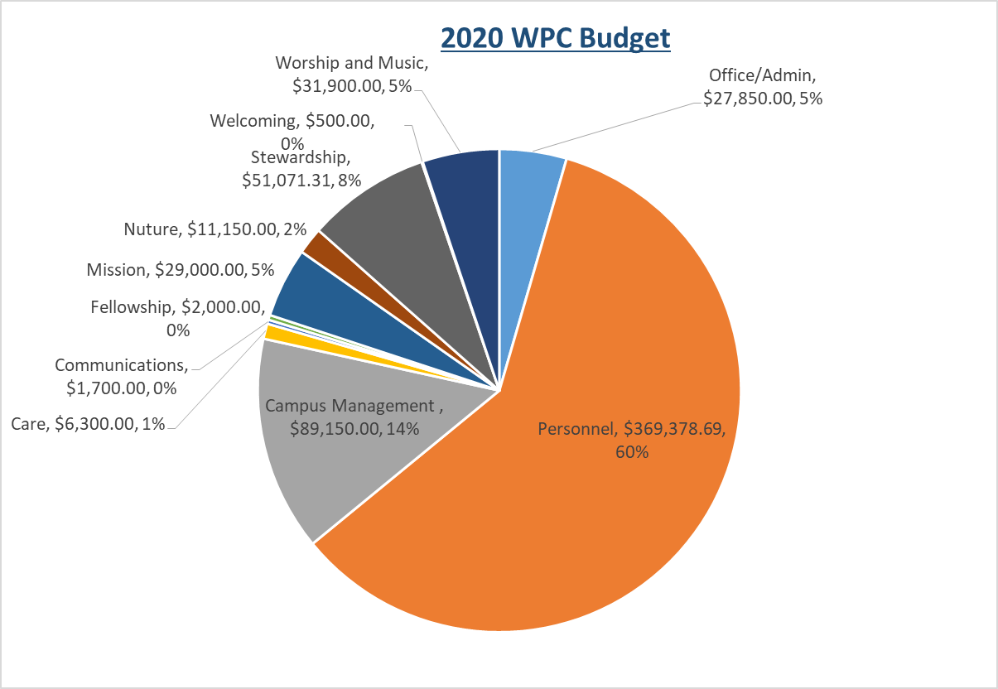

Slide 11
Vote
Motion from S&F Committee to set the 2020 WPC budget at $620,000.00

