Slide 1
WEBSTER PRESBYTERIAN CHURCH
2019 Budget
Jimmy Spivey
Treasurer
January 22, 2019

Slide 2
Past Revenues/Expenses

Slide 3
2019 Budget Summary
2016 Budget was $660,651.17
2017 Budget was $634,000.00
2018 Budget is $656,000.00
2019 Proposed Budget is $608,120.00
2016-2018 3yr giving Average is $655,884.99
2018 YTD giving was $639,491.39
  $22k surplus from 2017 not included
  Lowest giving number in last 8 years

Slide 4
Other 2018 Giving Outside the Budget
Mission = $59,827.16
  Gifts of Joy, Pentecost, McWhirter, Family Promise, Harvey Relief, Community Assistance, etc. (Does not include Mission Trips).
Mortgage Reduction = $84,703.75
Capital Campaign = $90,871.61
Total= $235,402.52
  Total Giving Operating/Outside =
  $874,893.91

Slide 5
2019 Proposed Budget Changes by Committee
Personnel - $(6,450.23) decrease overall
  Secretary raise - 3%
  AP Study Leave - $1200.00 increase
  Payroll expenses (PayChex service) - $1900.00 decrease
  Sr. Pastor Death Benefit increase – $471.62
  Family Coordinator 1/5 cut in hours – $6,180.00 decrease
Campus Management - $2,250.00 increase
  Lawn Maintenance - $500
  Electricity and water- $3,750 (based on 2018 actual cost)
  General maintenance - $1000 decrease
Care – $2675.00 increase
  Mental Health Counseling
  Grief Share
  Senior Ministry Speakers
  Powerful Tool/Care Givers

Slide 6
2019 Proposed Budget Changes by Committee
  Communications - $1000.00 decrease
  Fellowship - $725.00 increase
    Added Wednesday night dinner
  Mission – Stayed the same
  Family Ministry - $389.12 increase
  Adult Ministry - $1930 increase
    Teaching materials/Lecture series

Slide 7
2019 Proposed Budget Changes by Committee
Worship/Music - $18,250 increase
  Choir scholarships
Stewardship - $66,198.89 decrease
  Lower Insurance cost - 5K
  Roof loan paid off - 9K
  Mortgage paid off - 52k

Slide 8
2018 -2019 Budget
2018 Budget $656,000
2019 Budget $608,120
Total Revenues $639,491.39
Total Expenses $649,850.34
Office $25,350.00
Personnel $383,910.87
Campus Mgmt $79,100.00
Care $775.00
Communications $2,200.00
Fellowship $1,275.00
Mission $28,000.00
Nurture $5,820.00
Finance & Stewardship $116,219.13
Welcoming $500.00
Worship & Music $12,850.00
Pledged/Non-Pledged $600,000.00
Office $25,350.00
Personnel $377,460.88
Campus Mgmt $82,350.00
Care $3,450.00
Communications $1,200.00
Fellowship $2,000.00
Mission $28,000.00
Nurture $8,234.47
Finance & Stewardship $50,020.20
Welcoming $500.00
Worship & Music $29,650.00

Slide 9
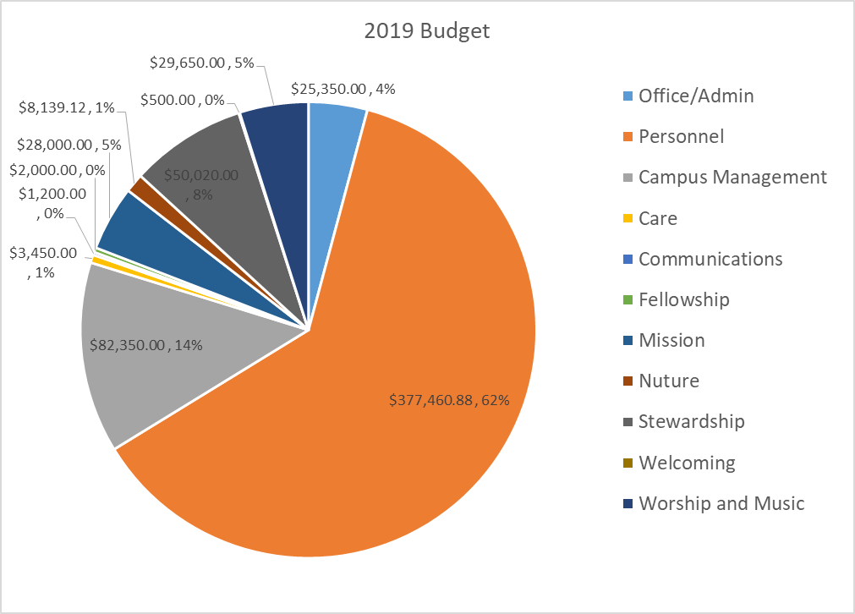

Slide 10
2019 Budget Analysis
Pledges to date are $459,234.00 plus if you add $100,000.00 unpledged – Total Income is 559,234.00
Based on unpledged members who pledge and give. We should get another 45K.

Slide 11
Recommendation & Next Steps
Session approve 2019 Budget at 608,120.00
Budget present to Congregation (Not approved) 1/27/19.
Congregation approved Pastors Terms of Call

Slide 12
2019 TERMS OF CALL
Pastor | Proposed 2017
Keith Uffman | $138,859.78
2018 =$138,388.16
Components of Terms of Call:
Effective Salary - $87,550.00 (includes salary, housing)
Benefits
  BOP Dues - $32,393.50 (paid to PCUSA Board of Pensions for medical insurance and retirement)
  Study Leave Allowance - $1,800.00
  Reimbursement of SECA tax - $6,688.82
  Optional benefits - $2,227.44
Reimbursed Expenses - $8,200.00 (travel, professional expenses, discretionary, cell phone)
5 weeks of paid vacation and 2 weeks of professional development

Slide 13
2019 TERMS OF CALL
Pastor | Proposed 2018
Helen DeLeon | $89,523.75
2018 =$88,323.75
Components of 2019 Terms of Call:
Effective Salary - $54,075.00 (includes salary, housing, medical FSA)
Benefits
  BOP Dues - $20,007.75 (paid to PCUSA Board of Pensions for medical insurance and retirement)
  Study Leave Allowance - $2,900.00
  Optional Vision & Dental - $157.68
Reimbursed Expenses - $11,800.00 (travel, discretionary, cell phone, retirement matching)
Four weeks of paid vacation and two weeks of professional development

