Slide 1
WEBSTER PRESBYTERIAN CHURCH
2018 Budget Presentation to Session
Jimmy Spivey
Treasurer
1-21-18
Amended 1-23-18

Slide 2
2017 End of Year Summary
Income = $662,773.72
Outlays = $630,780.15
Net = +$31,993.97
Budget was $634,000.00
  Underspent by $3,219.85
    Small underage's in many areas
  Giving was over by $28,773.72
  Session gets an A for budgeting and spending
  Congregation gets an A+ for giving

Slide 3
2017 End of Year (cont.)
Capital Campaign Fund Balance = $182,530.23
Mortgage Balance = $264,228.00
  Jan payments to be made from building fund gifts = $122,931.00
  January 2018 pre-paids to Building fund = 4000k
  After those payments to be made in January:
  New balance = $137,697.00
Endowment Fund Balance = $129,168.47
Roof Loan Balance = $8643.10

Slide 4
Past Revenues/Expenses

Slide 5
2018 Budget Analysis by S&F
2016 Budget was $660,651.17
2017 Budget is $634,000.00
2018 Proposed Budget was $672,401.72
  Increase of $38,401.72 (6.06%) from 2017 to 2018
2015-2017 3yr giving Average is $662,344.07
2018 proposed is $10,057.65 more than the 3 year average giving.

Slide 6
2018 Proposed Budget Changes by Committee
Admin - $ 1,998.00 increase (Computer and postage actuals)
Personnel - $17,429.65 increase
  Staff raises (1.5 - 3%)
  Campus Management - $3,640.00 increase
    Repairs and maintenance slight increase
    Fire alarm cost increase
  Mission - $4,000.00 increase
  Adult Ministry - $2,720.00 increase (Honorarium and Heritage Team added)
Worship/Music - $20,400.00 increase
  Added Organ/piano maintenance back
  Choir scholarships (12k)
  Increase for special musicians
Stewardship - $9,000 decrease
  Uses discount achieve by an extensive facility review last month

Slide 7
2018 Budget Analysis
2018 Budget | 672,401.72 | 3yr giving Average is $662,344.07
2018 Pledge | 516,832
2018 unpledged estimate | 112,000
2018 TOTAL | 628,832
2018 net | -43,569.72 | -10,057.65
S&F recommendation is to not set a budget greater than the 3 year giving average.
Set the 2018 giving to 2017 Budget (634,000)
Added 21k from 2017 surplus
Total giving (budget) = $655,941 (6,403.07 less than 3 year average giving).
655,941 - 672,401 = 16,460 Budget Shortfall

Slide 8
2018 Budget Analysis
Reductions made to balance budget:
CM – held repairs flat. Some overlap to Capital Campaign projects. Set utility's to actual. Overall CM still went up over 2018
Adult Ministry – did not add the honorarium and heritage team costs. Budget did increase by $1000.00
Music – did not add the Choir scholarships and reduced clinicians by half (new add). Music budget still went up by $7150.00

Slide 9
Final 2018 Budget
$655,941.00 ($656,183.05) 242.05 increase
  Increase of $21,940.96 (3.46%) $22,183.05 (3.50%) over 2017
Uses $21,941 $22,183.05 of 2017 surplus as income.
  Use it only if we need to.
Includes 3% raises for staff.
Mission budget increased by 4k
Increase for IT
  BTW the Treasurers computer hard failed in early January.

Slide 10
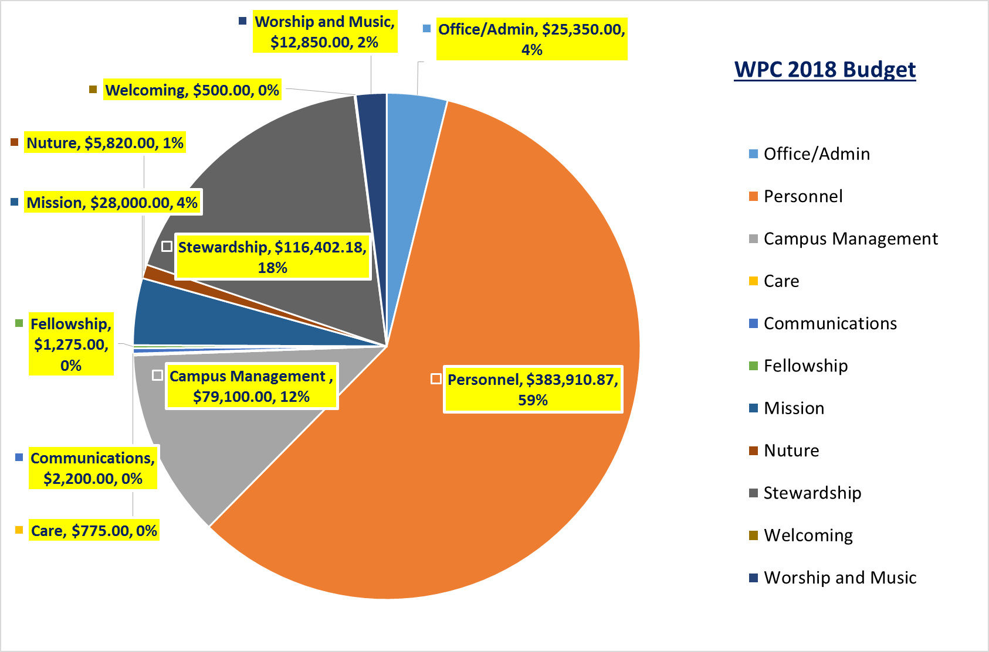

Slide 11
Summary
Need a motion to approve the 2018 Budget at 655,941.00 (656,183.05)

