Slide 1
WEBSTER PRESBYTERIAN CHURCH
Annual
Congregational Meeting
February 7, 2021

Slide 2
Agenda
Call to Order and Opening Prayer
Establishment of Quorum
Clerk’s Ministry Committee Reports and Membership Report
Presentation of the Budget
Approval of Terms of Call by Congregational Vote
Motion to Adjourn

Slide 3
Committee & Clerk’s Report for 2020
Ministry Committee Reports
  Available online on Family of Faith
Membership Report
Membership as of January 1, 2020
449 total; 245 Families
Membership as of December 31, 2020
447 total; 246 Families:
397 Active Members; 50 Baptized but not confirmed

Slide 4
2020 End of Year Financial Summary
Income = $617,155.11
Outlays = $567,520.44
Net = $49,634.67
Budget was $630,000.00
  Spending was under budget by $62,479.56
  Giving was under by $12,844.89

Slide 5
Other 2020 Giving Outside the Budget
Mission = $63,609.49
  Gifts of Joy, Pentecost, McWhirter, Family Promise, Harvey Relief, Community Assistance, Harvey meals
Capital Campaign = $43,386.27
Total= $106,795.76
  Total Giving Operating + Outside =
  $724,150.87

Slide 6
2019 End of Year (cont.)
Assets
Capital Campaign Balance = $68,637.27
Endowment Balance = $135,710.15
Debts
$0.00

Slide 7
2021 BUDGET
Session approved a 2021 annual budget of $615,000.00 on January 26, 2021
  This is a balanced budget
  Revenues from Pledged total, estimated non-pledged giving

Slide 8
2020 & 2021 Budget
2020 Budget $630,000
2021 Budget $615,000
Total Revenues $617,155.11
Total Expenses $567,520.44
Office $27,850.00
Personnel $369,378.69
Campus Mgmt $89,150.00
Care $6,300.00
Communications $1,700.00
Fellowship $2,000.00
Mission $29,000.00
Nurture $11,150.00
Finance & Stewardship $51,071.30
Welcoming $500.00
Worship & Music $31,900.00
Pledged/Non-Pledged $615,000.00
Office $23,950.00
Personnel $379,375.12
Campus Mgmt $84,050.00
Care $6,100.00
Communications $1,500.00
Fellowship $1,700.00
Mission $19,000.00
Nurture $5,150.00
Finance & Stewardship $57,664.88
Welcoming $200.00
Worship & Music $36,310.00

Slide 9
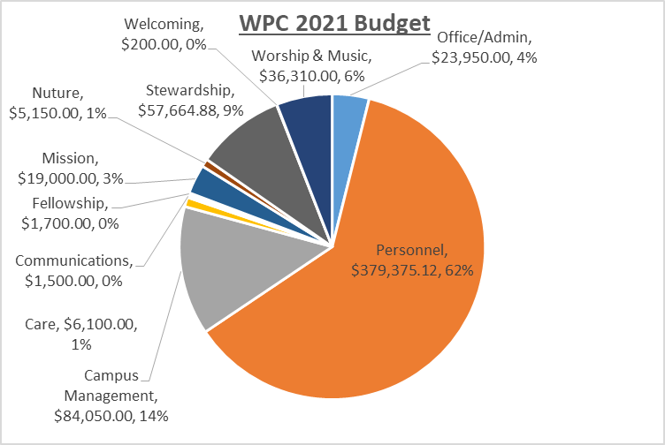

Slide 10
2020 TERMS OF CALL
Pastor | Proposed 2019
Keith Uffman | $141,401.34
2018 =$138,859.78
Components of Terms of Call:
Effective Salary - $89,301.00 (includes salary, housing)
Benefits
  BOP Dues - $33,041.37 (paid to PCUSA Board of Pensions for medical insurance and retirement)
  Study Leave Allowance - $1,800.00
  Reimbursement of SECA tax - $6,831.53
  Optional benefits - $2,227.44
Reimbursed Expenses - $8,200.00 (travel, professional expenses, discretionary, cell phone)
5 weeks of paid vacation and 2 weeks of professional development

Slide 11
2020 TERMS OF CALL
Pastor | Proposed 2019
Helen DeLeon | $74,956.17
2018 =$89,523.75
Components of 2019 Terms of Call:
Effective Salary - $44,460.41 (includes salary, housing, medical FSA)
Benefits
  BOP Dues - $16,234.49 (paid to PCUSA Board of Pensions for medical insurance and retirement)
  Study Leave Allowance - $1700.00
  Optional Vision & Dental - $157.68
  Soc Sec Supplement – $3203.59
Reimbursed Expenses - $9,200.00 (travel, discretionary, cell phone, retirement matching)
Four weeks of paid vacation and two weeks of professional development

Slide 12
MOTION TO APPROVE TOC
VOTE
MOTION TO AJOURN

