Slide 1

WEBSTER PRESBYTERIAN CHURCH
New (and not so new) Elder Financial Training
2014
Jimmy Spivey
Treasurer

Slide 2
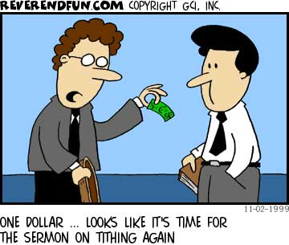
Agenda
Summary
Financial Team
Tools we use
Types of funds
Financial Process
Special accounts/events
Budget Process

Slide 3
Summary
Each Elder has a committee and corresponding Budget assignment.
You “own” that budget.
  Responsible for approving expenditures
  Responsible for staying on budget (for the most part)
  Responsible for adjusting/proposing the next years Budget
The Financial policy posted on the WPC Web pages describes in detail the context of these slides, along with other general information- good reference.

Slide 4
Financial Team
Treasurer –Staff reports to head of staff, and works closely Stewardship committee. Check signature authority.
Assistance Treasurer – Enters deposits, makes bank deposits, helps with direct deposits. Backup to Treasurer, has check signature authority.
Counters – counts offerings, enters into ACS. Leaves special offerings for T,AT, BK.
Book Keeper- Pays all bills. Makes entries into ACS, bank deposits. Does payroll. Closes the month/year. Has NO check signature authority.
Special Funds Committee – is made up of 3 trustees and 3 elected members from the congregation. They are charged with managing new designated funds and the endowment fund. All new requests for designated funds must go through this committee per the financial policy.

Slide 5
Tools we use/Reports
Accounting Church System (ACS)
  Financial Suite (Outlays)
    Monthly financial and other reports
  People Suite (Income)
    Contributions by name/organization
    Mailing lists, member lists, Pledges
PayChex
  Payroll and taxes
The treasurer will produce monthly financial reports (previous month) for each Session meeting.
  Includes monthly and YTD summary, details of operating and designated accounts, bank balance, and worship attendance.
  (Reports next page)

Slide 6
ACS REPORT

Slide 8
Types of Funds
Operating account
  Funds for regular expenditures (salary, utilities, repairs, worship, welcoming supplies)
Designated account
  Accounts set aside for a specific purpose. For example, Memorials, New projects, missions. Building fund is a designated account
Pass Thru or Exchange accounts
  Monies we collect and then give out.
  Wednesday night dinner, adult & youth trips, etc.
Endowment Fund
  Earn Interest off this fund. ½ goes to Mission, ½ to building fund
  Only the Treasurer can create new accounts.

Slide 9
Financial Process
All expenditures must be approved by an elder
  Exception is regularly monthly bills, - salaries, utilities.
  Head of staff or AP can approve expenditures if elder cannot in a timely manner.
A reimbursement form (green sheet) with account number from where the expenditure comes from and receipt must be given to BK for fund distribution. Form needs printed name and signature.
Elders cannot sign off on a reimbursement to themselves. Head of staff or AP has to sign.
Funds spent should be submitted within two months of expenditure.
Also in lieu of dollars, we can issue a non-monetary receipt for a gift. Donor fills out non cash form, we sign and return - Saves WPC $ and gives you a tax receipt gift. (ex. bought food)

Slide 10
Credit Cards
WPC has 6 Credit Cards
  Head of Staff, AP, Youth Coor, Director of Children’s Ministry, Music Director, Generic Office Card.
Cards are used due to the convenience and savings of on-line purchases.
Card statements are reviewed by BK
Cards should never be used for personal purchases.

Slide 11
Special Events/Donations
Please inform the Treasurer immediately upon creating a fundraiser or if funds are to be collected for a special purpose (Presby Disaster Relief, new mission trips, retreats, etc.
  Account needs to be set up by Treasurer
  Counters, BK, and AT, need to know that funds are coming in for a specific purpose so the donations can be properly recorded
Sometimes members give staff or elders checks for certain purposes
  Inform the Treasurer and Chair of Special Gifts committee immediately

Slide 12
Annual Financial Reviews
WPC conducts an annual financial review
  Lead by member of Stewardship Committee
Treasurer/BK are not part of the review.
If the review members determine, an Audit can be requested.
  Outside firm, very expensive.

Slide 13
Budget Process
Annually each committee proposes a budget for the following year.
In September, the Stewardship Chair/Treasurer will collect inputs from each committee.
Then at the October session meeting the new budget is presented to Session.
Session approves taking that proposed budget to the Congregation during the annual Stewardship Luncheon
In mid-January once the previous year is closed, the pledges have been tallied, the Stewardship Chair/Treasurer will present the proposed budget to the Session along with the Projected revenue and inputs from the previous years’ financial data.
Adjustments are made and the Session votes and approves the budget.
That Approved Budget is presented to the congregation for information at the annual meeting in late January

Slide 14
Session Authority
Session has authority of all funds that come into WPC.
  Session approves the budget, not the congregation. Congregation only votes on the terms of call for Installed Pastors. (Interim Pastor is under contract approved by session. )
  Session sets priorities for expenditures.
  Session can vote to use designated funds for different purpose.
Most of the financial team is volunteer (so hug them when you see them). And the BK is underpaid for what she does (so hug her too).

Slide 15
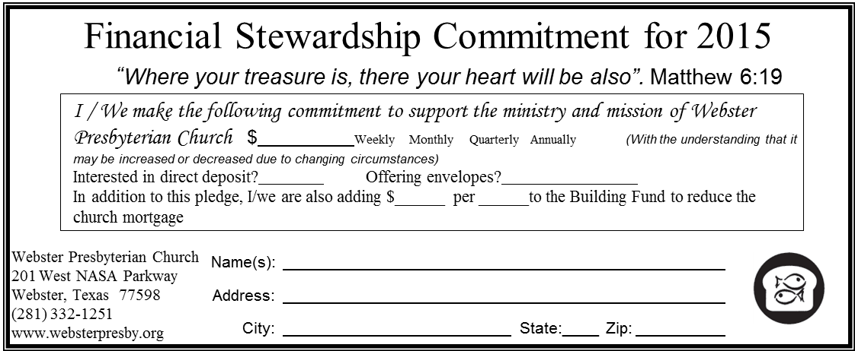
Pledges - Card & Via Web
2014 Stewardship
Download a commitment letter or complete your form online

Slide 16
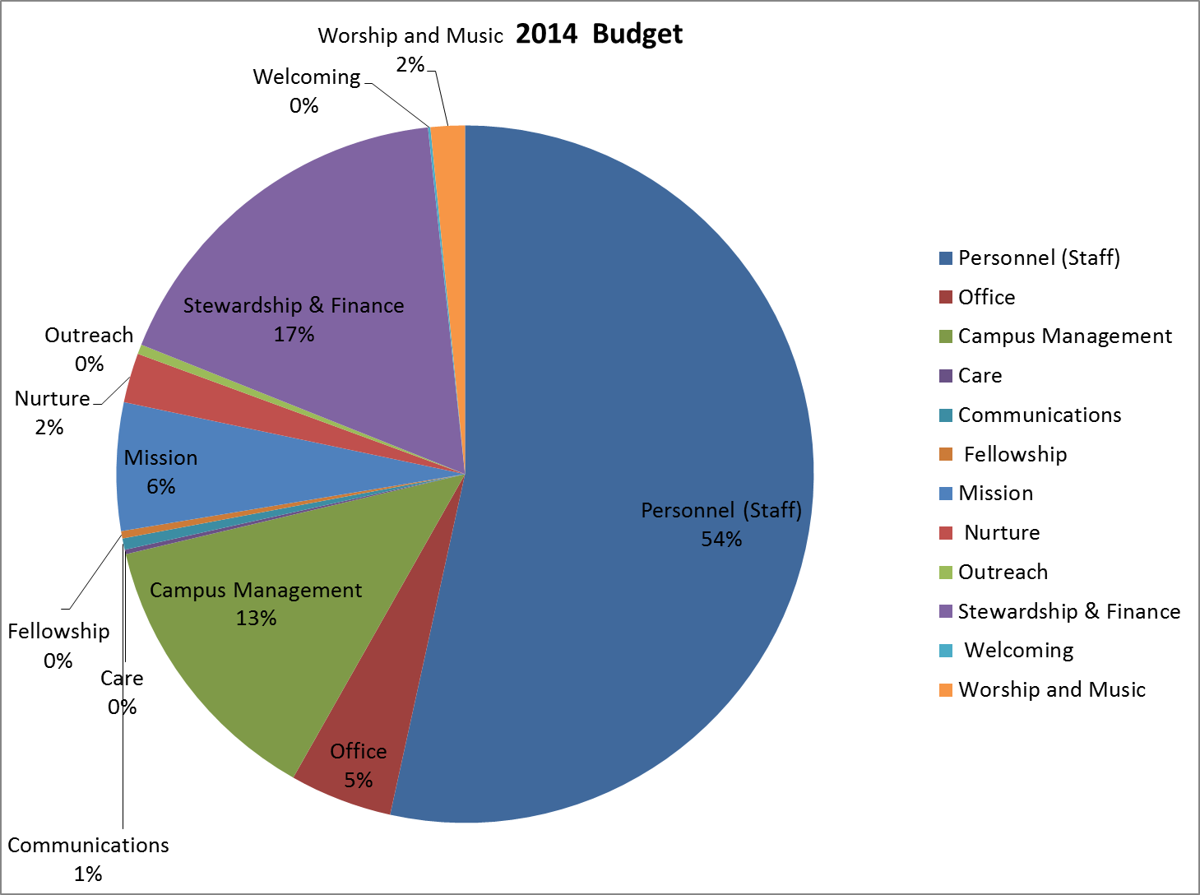

Slide 17
2011-2014 Financial Summary
 | Budget | Pledged Amount | Pledges Received | Total Receipts | Total Expense | Net Receipts
2011 | $764,000 | $689,292 | $731,000 | $745,904 | $742,508 | $3,396
2012 | $682,000 | $607,000 | $611,905 | $693,335 | $645,353 | $47,982
2013 | $669,372 | $594,792 |  | $653,153 | $656,599 | $38,710*
2014 | $674,736
* - including previous year roll thru of $42,197

Slide 18
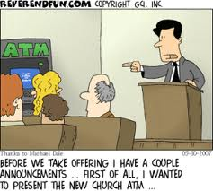
Questions?

