Slide 1

Youth Activities
Spring and Summer 2012
Webster Presbyterian Church
. . . worship, service, and fellowship . . .

Slide 2
Conclaves
SH Mission Trip
JH Weekend Mission Trip
Car Wash
Youth Synod Workshop
VBS & VBS After Hours
JH Jubilee at Mo Ranch
Casting Crowns Concert

Slide 3


March 2-4
Conclaves

Slide 4
JH Jubilee
Video

Slide 5

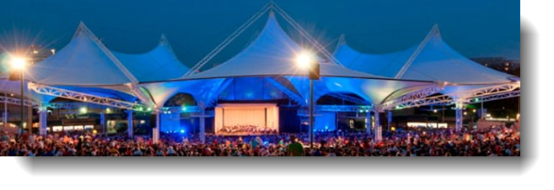
E-mail Kevin by 26Feb if interested in attending with number of tickets wanted; will order tickets on 27Feb.
Saturday May 5th
$28.05 / $42

Slide 6
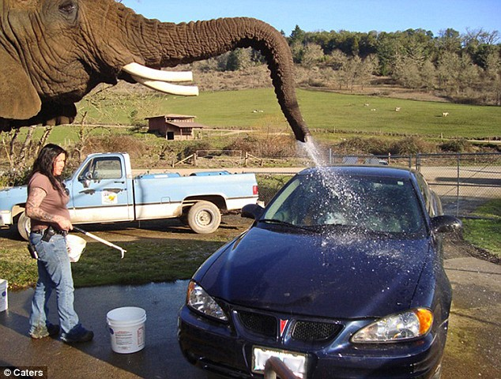
Car Wash
Date: TBD

Slide 7
VBS & VBS After Hours
June 3 - 7

Slide 8

SH Mission Trip
Date Change
June 17-23
Approximately $150

Slide 9
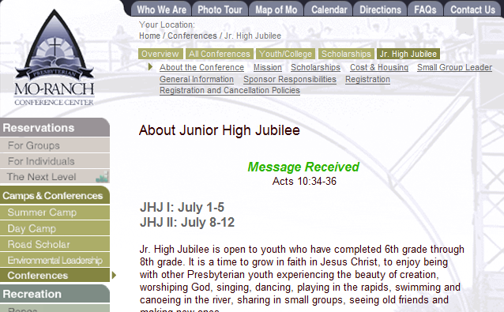
E-mail Kevin if attending by 26 Feb as will reserve with Mo Ranch on 27Feb
Cost: $250
Stated preference 8-12 July

Slide 10
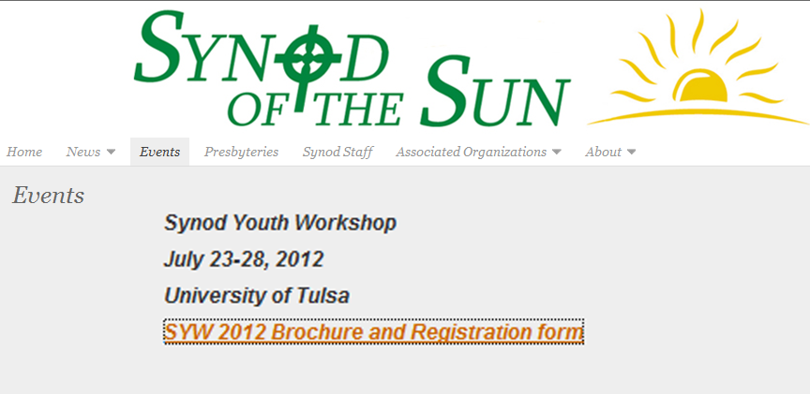
Video
Cost: $325
WPC Video
Entering 10th, 11th,12th or first year of college

Slide 11
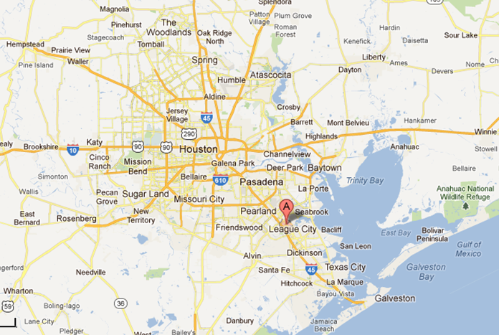
JH Weekend Mission Trip: TBD
Local
2-3 days
Overnight

Slide 12
Adult volunteers
We have as much fun as the youth!
Provide guidance
Costs are covered
Central planning, weekly execution
Oh, and did I say,
we have as much fun as the youth!

Slide 13
Worship
Service
Fellowship
PYC
at
Webster

