Slide 1

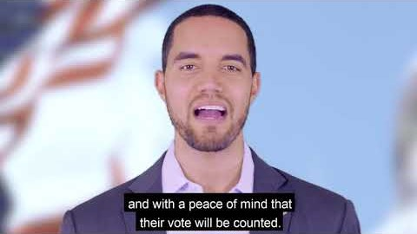
Harris County Voting Centers
  October 13 - October 30
  November 3
DOES YOUR FACILITY MEET THE NEEDS OF A VOTING CENTER?
Has a room at least 1,500 square feet;
Is up to code under the Americans with
Disabilities Act with accessible parking
and wide hallways
Can commit to providing your space from
5:30 AM to 11:00 PM on Election Day
CHRIS HOLLINS
HARRIS COUNTY CLERK
https://harrisvotes.com/becomeavotingcenter
The November 3rd Election is just around the corner and we are predicting record voter turnout.
That means we need more election workers and more voting centers to meet the needs of our Harris County neighbors to exercise their right to vote.

Slide 2
Why?
Democracy is part of being Presbyterian in the United States
Consistent with our vision: Webster Presbyterian Church is an evolving spiritual community joyfully serving Christ as active disciples. We welcome ALL alongside us to create a more loving, affirming, just and sustainable world, valuing spiritual inquiry, civility of discourse, scientific ideas, and artistic expression
Respond to community needs during a pandemic: High voter turn-out is expected. Addition of polling places reduces the density of voters in a single polling place
Voting is a solitary activity, much like the sanctuary being open on Thursdays for reflection and prayer
A “stepping stone” to re-opening the campus and corporate worship

Slide 3
Facility
Facility needs to be “up to ADA code”, County will provide a no cost inspection and report
Facility must be at least 1500 square feet to support social distancing
WPC can limit bathroom access to poll workers only
WPC can provide the Election Judge a key OR have someone there to open and close the facility
No support is required throughout the day
They will need 4-5 tables and about 15 chairs. If we don’t offer them the county can provide them

Slide 4
Administration
CDC guidelines are to be followed
  Social distancing
  Face masks provided by Harris County
  Finger protection will be provided to voters touching the machine
  Hand sanitizer dispenser provided by the county
Daily cleaning is not required. However WPC can charge the county “$50 – 100 per day” for cleaning
We will be notified by the “beginning of September”
Volunteering now puts WPC in the pipeline for future polling location needs
Congregants who want to volunteer to support the election can volunteer: https://www.harrisvotes.com/PollWorkers?lang=en-US#WorkingAtThePolls

Slide 5
Specifics
Early voting (October 13 – 31):
  There are two facilities in our area that have hosted early voting in the past. However, they have not yet been confirmed for this year.
  Facility would be needed from 6 am until 11 PM, every day of the week
  Set up day is October 9
Regular voting (November 3):
  If we are chosen it will most likely be for voting day (November 3).
  Set up day is November 2
  Facility would be needed from 6 am until 11 PM

Slide 6
Qualifying questions
Are you available on Tuesday, November 3, 2020 from 6 a.m. to 11 p.m.? *
Facility Name *
Facility Address *
Was this facility requested by Harris County or are you recommending it as a new location?
Point-of-Contact *
Contact Number *
Email Address *
Voting Room # / Name *
What is the square footage of the voting area / room? *
Is there a larger room or space at your facility that could be used for voting?
Do you have floor plans that include the voting room? *
How many parking spaces are available? *
How many van accessible parking spaces are available? (these are your handicap marked spaces) *
Do you have a covered parking lot or garage? *
If you do you have a covered parking lot or garage, how many parking spots are in that covered area?
Would you be willing to make your facility available for the entire voting period from Tuesday, October 13, 2020 – Friday, October 30, 2020, from 6 a.m. to 11 p.m.? *
What days are you available?
Comments, if needed:

Slide 7
Possible motions
Designate a WPC contact
Authorize volunteering Fellowship Hall for
  Early Voting (October 13 – 31) and associated set up (October 9)
  AND/OR
  Regular Voting (November 3) and associated set up (November 2)

Slide 8
Thank you WPC Polling Place Task Force
Jimmy Spivey
Anya Ezhevskaya
James Kinzler
Sandy Dwyer
Bill Dixon
With input from the WPC Vision Team and session

Slide 9
Resources

Slide 10
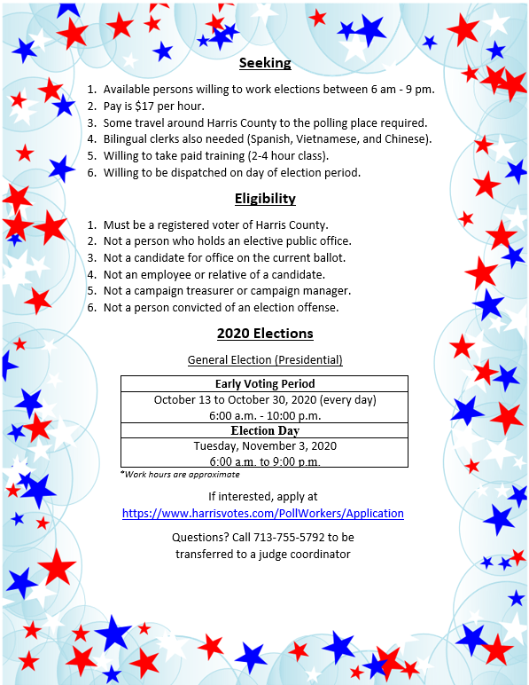
Harris County Election Workers
DO YOU KNOW SOMOENE WHO WOULD BE WILLING TO SERVE AS AN ELECTION WORKER?
At least 16 years of age
A registered voter of Harris County or
a high school clerk age 16 or 17
Available for at least one of the periods below:
  October 13 – October 30, 2020
  (from 6 am to 8 pm or later)
  Tuesday, November 3, 2020
  (from 6 am to 8 pm or later)
  Pay is $17
  per hour
https://harrisvotes.com/PollWorkers/Application
The November 3rd Election is just around the corner and we are predicting record voter turnout.
That means we need more election workers and more voting centers to meet the needs of our Harris County neighbors to exercise their right to vote.

Slide 11
Election Worker Flyer

