Slide 1
Initial CPTF Recommendation
WPC should be very grateful to members who have maintained and repaired our campus over the past years.
Many members, including members of the Campus Management Team, have dedicated many hours addressing the needs of our campus.
Session should acknowledge and thank them for their past work and continued support.

Slide 2
Our Responsibility as Inheritors of WPC
1 Corinthians 3:5-11
3:5 What then is Apollos? What is Paul? Servants through whom you came to believe, as the Lord assigned to each.
3:6 I planted, Apollos watered, but God gave the growth.
3:7 So neither the one who plants nor the one who waters is anything, but only God who gives the growth.
3:8 The one who plants and the one who waters have a common purpose, and each will receive wages according to the labor of each.
3:9 For we are God's servants, working together; you are God's field, God's building.
3:10 According to the grace of God given to me, like a skilled master builder I laid a foundation, and someone else is building on it. Each builder must choose with care how to build on it.
3:11 For no one can lay any foundation other than the one that has been laid; that foundation is Jesus Christ.

Slide 3

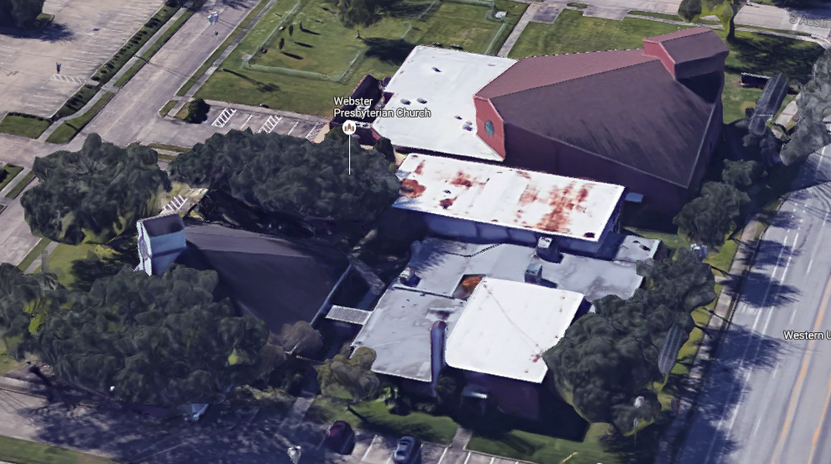
CPTF Charter
⁸ For once you were darkness, but now in the Lord you are light. Live as children of light— ⁹ for the fruit of the light is found in all that is good and right and true. Ephesians 5: 8-9 NRSV
The CPTF is to shine the light of the Lord on the WPC Campus

Slide 4

CPTF MEMBERS
Karla Bradley Coco Motley
Courtenay Clifford Joe Schwarz
Kathy Dixon Reese Terry
James Kinzler Dennis Waehner
Al Manson
Scott McNeill (CM representative until 1 Nov)
Ken Thompson (CM representative after 1 Nov)

Slide 5
CPTF To Do List
Identify capital issues (for example roof repair, deteriorating organ and others) threating the financial stability of WPC
  Consider the church debt
  Consider the overall health of the campus facilities (maintenance projects require capital)
  Address current and future needs and how to meet those needs
  Review the Comprehensive Long-Range Master Plan, July 2000, Bay Architects
  Consider relocating to better serve the needs of congregation and to better fulfill our vision
Develop options of what should be done, the associated cost, and proposals for paying for them
Report to the Session who has the responsibility to decide what to do and to present it to the congregation for their approval

Slide 6
What the CPTF Did
Met over 20 times and started every meeting with a devotion and prayer
Brainstormed projects to improve the welcoming environment of our campus
Sought Congregation’s input on needed campus changes
Had conversations with experts:
  City of Webster Planners
  Lorrie Foreman, CEO of Venturi Outcomes and General Contractor and Project Manager
  Rick Wade, Commercial Real Estate Broker
  Kevin Story, Story Architects
  Several contractors to obtain project estimates
  Local PC (USA) churches that ran a capital campaign
Reviewed the following
  Early History of the campus, "Little White Church on NASA Road One“ (1993)
  Comprehensive Long-Range Master Plan from Bay Architects (2000)
  Final Report of the WPC Membership Coordinating Team (March 19, 2015)
  Community Demographics from Presbyterian Church (USA)
  Facility Energy Assessment and Recommendations (February 3, 2016)
Received Reports from a Commercial Building Inspector and a Plumbing Inspector
Developed a list of projects including descriptions, costs, and benefits

Slide 7
Overall Findings
Overall
  The congregation has a lot of faith in this church and is passionate about its future
  WPC is in a good location in the center of the City of Webster
  WPC has a wonderful campus with sound buildings
  There is room for expansion on this campus
  Current debt is about $376,200.00
Relocation
  WPC is a destination church and moving won't change that
  It makes no sense to move because WPC would have to pay off current debt and incur new debt
  If WPC acquired another property, WPC would have similar problems, including a debt
Campus usage
  There is more room in our buildings than WPC needs, but there is no viable way to scale back
  Demolition of any building would require a new building for the functions lost
  The 2002 Master Plan, of which most Part 1A and some of Part 1B are completed, is no longer applicable
Condition of Buildings
  Maintenance has been low priority for years, to come back in line will be over $170,000 for back-maintenance (some not estimated)
  In addition there are many maintenance projects that should be planned for the next 2 to 3 years that will be at least $100,000
  All buildings have water leak problems
  These are commercial buildings and should be maintained by professionals under the direction (albeit temporarily) of an architect
Sanctuary Organ
  Organ needs significant maintenance and repair

Slide 8
WPC Building Water Leaks
These water leaks should be the top priority for repair; delay will result in increased cost.
Sanctuary
  Leak on southwest side floods Pray Grounds (root cause unknown)
  Stucco exterior wall with micro cracks
  Damaged gutters
  Leak in narthex over entry to Sanctuary (recently repaired but still appears to leak)
Fellowship Hall
  Stucco exterior wall with micro cracks
  Old roof that needs replacement now
  Damaged window frames
Admin / CE building
  Stucco exterior wall with micro cracks
  Recently repaired roof may still have problems
  Water stains of the ceiling tiles in Admin Building (Meeting Room, Bouton Hall, Pastor Office) (root cause unknown)
  Old iron drainage pipes (inside the structure)
  Damaged stained glass window frames
  Damaged windows on NASA 1 side of CE building
  Leaking windows in Helen's office and in the Bookkeeper office

Slide 9
CPTF “List of Projects”
The “List of Projects” include the maintenance and improvement projects that were identified by the CPTF as a part of our effort to identify capital projects that improve the viability of facilities and welcoming of our campus.
It was not within the scope of the CPTF responsibilities to place priority on or eliminate any potential projects. However, we expect that some listed projects will never be implemented.
The criteria for the project order in the “List of Projects” are: 1) ones that threaten escalating damage to our buildings (such as water damage) and ones identified by the inspectors as “Maintenance Projects NOW”; 2) “Maintenance Projects 1 to 3 Years”, and then 3) building improvements and other projects.
The cost estimates in the “List of Projects” are rough order of magnitude estimates and the actual cost may vary after the project is fully specified.
CPTF Recommendations for management of the “List of Projects”
  Campus Management Committee should be responsible for the examination of all projects and addressing the ones that over time become important
  Campus Management Committee should review the project priorities annually and repeat the building inspection and project list generation processes at least every 5 years.

Slide 10
CPTF Recommendations to Session
Session should:
  Run a capital campaign that focuses on raising money for:
    Paying off the debt
    Funding maintenance and improvement projects
  Select a team with fundraising skills to run the capital campaign
  Make campus management a larger part of the annual budget
  Make giving for capital projects part of the annual stewardship campaign
  As capital money is available, choose projects from the “List of Projects” to implement
  Use debt vehicles only in an emergency (i.e., if the money is not on hand - don’t do it)
  Engage an architect for the church (such as Story Architects) to help with project specification and overall campus planning (at least for major renovations and projects and to help identify which projects can be assigned to our members to accomplish)
  Make effective use of WPC membership for some projects
  Not consider relocation
  Not consider the demolition of any of the buildings
  Make it a priority to increase usage of our campus
  Decide to either repair, replace, or remove the organ

Slide 11
How Much is Available if
Session may elect to change the percentages or split the funds raised into different categories.
This spreadsheet provides several examples of capital campaign totals. Each campaign total assumes $376,200 in debt. In these examples the raised money would go to capital maintenance at 25% , and to capital improvement projects at 25%, and the balance to debt payment. Once the debt is paid, 25% goes to improvement projects, and the balance goes to maintenance projects.
Highlighted in green are the raised amounts that pay off the debt given the entered percentages.
The spread sheet is embedded, double clicking will allow changes.
Only the three numbers highlighted light yellow should be changed.
Changes in the yellow cells will automatically change the green shading.

Slide 12
Make Effective use of WPC Membership
What Projects can we do Ourselves?
The CPTF and WPC Members identified many projects that are maintenance related and within the capability of volunteer non-professionals. We believe our Campus Management Team could lead our volunteers to execute some projects with the following considerations.
  Hands on project work, in service to WPC’s mission, generates a sense of community
  Of the projects identified in the CPTF process, generate a list of projects that would fit for WPC volunteers
  Publish a project list and request volunteers specifically for individual projects and stress that working a specific project does not immediately place you on a committee
  Review projects with a professional to ensure we are not having volunteers perform work that would ultimately lead to failure or greater damage at a later date.
  Suggest a rally or meeting of the handy folks of the Church to include an effort to inventory who are we, what can we do, how to get others involved.
  As we “do it ourselves”, focus on safety and prevention by listing hazards and ensuring the prevention is in place
  Set a steering team of older, middle and younger folks to ensure that the communications and the projects are fit for “us”

Slide 13
It can be Done!
Joash Repairs the Temple
2 Chronicles 24 NRSV
⁴ Some time afterward Joash decided to restore the house of the Lord.
⁸ So the king gave command, and they made a chest, and set it outside the gate of the house of the Lord. ⁹ A proclamation was made throughout Judah and Jerusalem to bring in for the Lord the tax that Moses the servant of God laid on Israel in the wilderness. ¹⁰ All the leaders and all the people rejoiced and brought their tax and dropped it into the chest until it was full. ¹¹ Whenever the chest was brought to the king’s officers by the Levites, when they saw that there was a large amount of money in it, the king’s secretary and the officer of the chief priest would come and empty the chest and take it and return it to its place. So they did day after day, and collected money in abundance.¹² The king and Jehoiada gave it to those who had charge of the work of the house of the Lord, and they hired masons and carpenters to restore the house of the Lord, and also workers in iron and bronze to repair the house of the Lord. ¹³ So those who were engaged in the work labored, and the repairing went forward at their hands, and they restored the house of God to its proper condition and strengthened it.

Slide 14
What the CPTF Delivered
  CPTF Report to Session including backup information (these slides)
  “List of Projects” including Project Descriptions
  Commercial Building Inspector Reports (three)
  Commercial Plumbing Inspector Report
  The real estate Market Analysis Proposal
  Miscellaneous attachments
    Story Architects brochure
    Are we Ready for a Capital Campaign? (Horizons Stewardship)
    Essentials of Fundraising for Churches (ECCU Investing in Ministry)
    Various project proposals

Slide 15
Additional Details
The following slides cover these topics
  Campus Description
  Campus Buildings Status
  Campus Real Estate Value
  WPC Debt Status as of January 2017
  Suggested Best Practice for the CM Budget
  Lorrie Foreman Assessment
  Early Campus History (1893 to 1990)
  City of Webster
  Where do our members live
  Summary of 2000 Master Plan
  Capital Campaign Considerations
The topic titles are hyperlinked to the appropriate slide with a return hyperlink to this page at the button or each slide

Slide 16
2016 Campus Description
WPC is located approximately 20 miles south of downtown Houston on NASA Road 1, one block southwest of Highway 3 and .8 miles northeast of I 45 in the City of Webster
Church campus consist of 3.4 Acres in two parts:
  ~2.3 acres off NASA Road 1 (Bordered by NASA Road 1, Austin St., Houston St., and Moody St.)
  ~1.1 Acres on the south side of Moody St.
Parking:
  Head-in parking along Houston St. provides 14 spaces and 2 accessible spaces
  Parallel parking on Austin St. provides 3 spaces
  Drop-off Parking on Moody St. provides 1 space and 9 accessible spaces
  Main Parking Lot south of Moody St. provides 139 spaces
  Total site parking: 157 spaces and 11 accessible spaces
Of the 2.3 acres, about 0.6 acres along Austin St. is undeveloped, and some space is available along Moody St. for Fellowship Hall expansion
The structures are:
Campus Phases | Size | Year Dedicated | Notes
Sanctuary | 14,500 sq. ft. | 2004
Fellowship Hall | 6,200 sq. ft. | 1983 | Sanctuary from 1983 through 2004
Bouton Hall & Kitchen | 2,700 sq. ft. | 1974
Education Building | 9,100 sq. ft. | 1966 | 2 Story CE Building and Bassett Parlor
Administrative Wing | 6,500 sq. ft. | 1960 | Sanctuary from 1960 through 1983
Return to presentation
Return to Additional Details

Slide 17
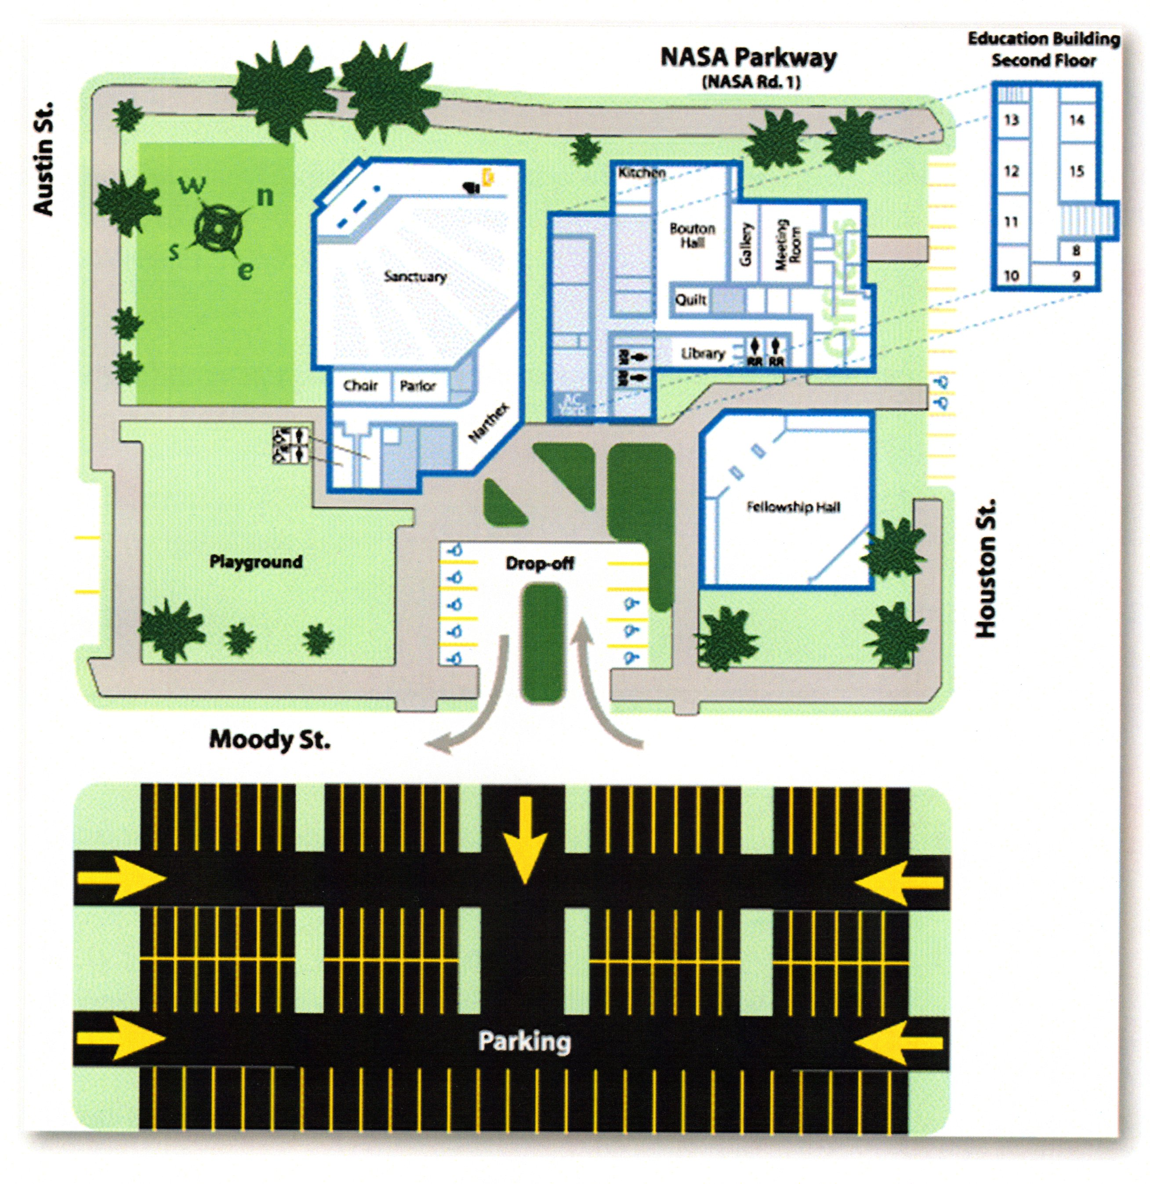
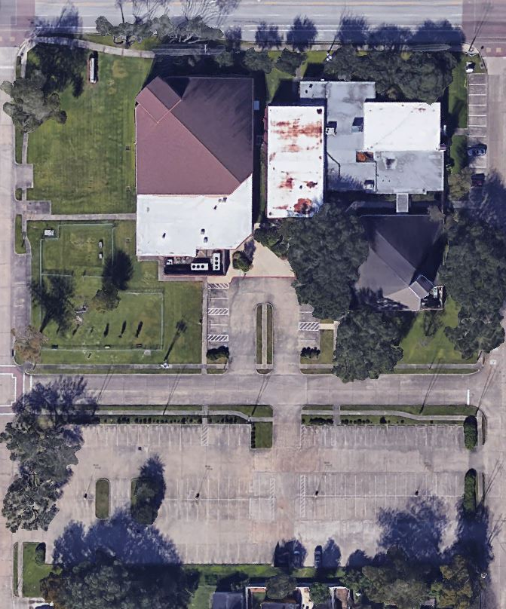
2016 Campus Overhead View and Map
Return to presentation
Return to Additional Details

Slide 18
City of Webster Campus Plat Map
Return to presentation
Return to Additional Details

Slide 19
Campus 2016 Real Estate Value
Real Estate Market Analysis Proposal
Current value of WPC property
$2,900,000 to $3,200,000
Rick Wade
Commercial Real Estate Broker
REMAX Space Center
Return to Additional Details

Slide 20
Current Debt as of January 1, 2017
Current (1/1/2017) building loan: ~$360,100. A $25,000 payment will be made in January. The final payment of the current loan is due on August 12, 2020, with a balloon payment of $365,334.59. Any remaining balance will be refinanced at rates at that time. Current projections have this debt paid off by June, 2025.
Current (1/1/2017) roof repair loans: ~$16,100. (Originally in 2015 WPC browed $43.1K: $21K from Amegy Bank, $15K from Presbytery, and $7.1K from WPC Endowment.)
Total debt as of January 1, 2017, is $376,200.
Return to presentation
Return to Additional Details

Slide 21
Lorrie Foreman
Assessment of WPC Campus
Lorrie Foreman, CEO of Venturi Outcomes and a general contractor specializing in nonprofit projects, provided the following assessment:
You have a wonderful campus, the bones are sound, but it needs maintenance and upkeep
The kitchen is a real asset
Her top three improvement suggestions are:
  Update the first floor of the CE Building
  Install a covered walk way between the Sanctuary and the CE Building
  Add attractive landscaping on the south side of the drop off area
Sound recording of the conversation with Lorrie Foreman are available in the Church Office.
Return to What we did
Return to Additional Details

