Slide 1
CAPITAL PLANNING TASK FORCE REPORT
Delivered on February 1, 2017, to the Session of
Webster Presbyterian Church
God is calling Webster Presbyterian Church to be a place of worship in the Greater Bay Area that welcomes all God ’s children and serves Christ as active disciples to create a more loving, affirming, and just world through openness to spiritual inquiry, civility of discourse, scientific ideas, and artistic expression.

Slide 2
Initial CPTF Recommendation
WPC should be very grateful to members who have maintained and repaired our campus over the past years.
Many members, including members of the Campus Management Team, have dedicated many hours addressing the needs of our campus.
Session should acknowledge and thank them for their past work and continued support.

Slide 3
Our Responsibility as Inheritors of WPC
1 Corinthians 3:5-11
3:5 What then is Apollos? What is Paul? Servants through whom you came to believe, as the Lord assigned to each.
3:6 I planted, Apollos watered, but God gave the growth.
3:7 So neither the one who plants nor the one who waters is anything, but only God who gives the growth.
3:8 The one who plants and the one who waters have a common purpose, and each will receive wages according to the labor of each.
3:9 For we are God's servants, working together; you are God's field, God's building.
3:10 According to the grace of God given to me, like a skilled master builder I laid a foundation, and someone else is building on it. Each builder must choose with care how to build on it.
3:11 For no one can lay any foundation other than the one that has been laid; that foundation is Jesus Christ.

Slide 4

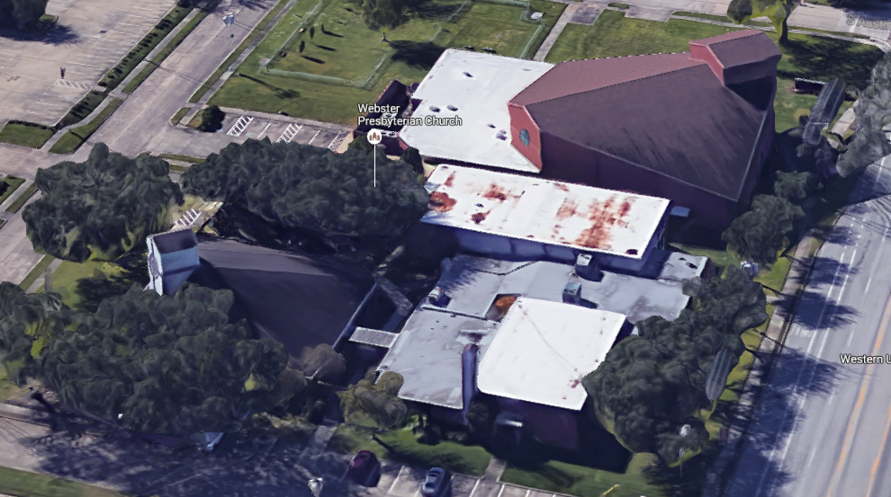
CPTF Charter
⁸ For once you were darkness, but now in the Lord you are light. Live as children of light— ⁹ for the fruit of the light is found in all that is good and right and true. Ephesians 5: 8-9 NRSV
The CPTF is to shine the light of the Lord on the WPC Campus

Slide 5

CPTF MEMBERS
Karla Bradley Coco Motley
Courtenay Clifford Joe Schwarz
Kathy Dixon Reese Terry
James Kinzler Dennis Waehner
Al Manson
Scott McNeill (CM representative until 1 Nov)
Ken Thompson (CM representative after 1 Nov)

Slide 6
CPTF To Do List
Identify capital issues (for example roof repair, deteriorating organ and others) threating the financial stability of WPC
  Consider the church debt
  Consider the overall health of the campus facilities (maintenance projects require capital)
  Address current and future needs and how to meet those needs
  Review the Comprehensive Long-Range Master Plan, July 2000, Bay Architects
  Consider relocating to better serve the needs of congregation and to better fulfill our vision
Develop options of what should be done, the associated cost, and proposals for paying for them
Report to the Session who has the responsibility to decide what to do and to present it to the congregation for their approval

Slide 7
What the CPTF Did
Met over 20 times and started every meeting with a devotion and prayer
Brainstormed projects to improve the welcoming environment of our campus
Sought Congregation’s input on needed campus changes
Had conversations with experts:
  City of Webster Planners
  Lorrie Foreman, CEO of Venturi Outcomes and General Contractor and Project Manager
  Rick Wade, Commercial Real Estate Broker
  Kevin Story, Story Architects
  Several contractors to obtain project estimates
  Local PC (USA) churches that ran a capital campaign
Reviewed the following
  Early History of the campus, "Little White Church on NASA Road One“ (1993)
  Comprehensive Long-Range Master Plan from Bay Architects (2000)
  Final Report of the WPC Membership Coordinating Team (March 19, 2015)
  Community Demographics from Presbyterian Church (USA)
  Facility Energy Assessment and Recommendations (February 3, 2016)
Received Reports from a Commercial Building Inspector and a Plumbing Inspector
Developed a list of projects including descriptions, costs, and benefits

Slide 8
Overall Findings
Overall
  The congregation has a lot of faith in this church and is passionate about its future
  WPC is in a good location in the center of the City of Webster
  WPC has a wonderful campus with sound buildings
  There is room for expansion on this campus
  Current debt is about $376,200.00
Relocation
  WPC is a destination church and moving won't change that
  It makes no sense to move because WPC would have to pay off current debt and incur new debt
  If WPC acquired another property, WPC would have similar problems, including a debt
Campus usage
  There is more room in our buildings than WPC needs, but there is no viable way to scale back
  Demolition of any building would require a new building for the functions lost
  The 2002 Master Plan, of which most Part 1A and some of Part 1B are completed, is no longer applicable
Condition of Buildings
  Maintenance has been low priority for years, to come back in line will be over $170,000 for back-maintenance (some not estimated)
  In addition there are many maintenance projects that should be planned for the next 2 to 3 years that will be at least $100,000
  All buildings have water leak problems
  These are commercial buildings and should be maintained by professionals under the direction (albeit temporarily) of an architect
Sanctuary Organ
  Organ needs significant maintenance and repair

Slide 9
WPC Building Water Leaks
These water leaks should be the top priority for repair; delay will result in increased cost.
Sanctuary
  Leak on southwest side floods Pray Grounds (root cause unknown)
  Stucco exterior wall with micro cracks
  Damaged gutters
  Leak in narthex over entry to Sanctuary (recently repaired but still appears to leak)
Fellowship Hall
  Stucco exterior wall with micro cracks
  Old roof that needs replacement now
  Damaged window frames
Admin / CE building
  Stucco exterior wall with micro cracks
  Recently repaired roof may still have problems
  Water stains of the ceiling tiles in Admin Building (Meeting Room, Bouton Hall, Pastor Office) (root cause unknown)
  Old iron drainage pipes (inside the structure)
  Damaged stained glass window frames
  Damaged windows on NASA 1 side of CE building
  Leaking windows in Helen's office and in the Bookkeeper office

Slide 10
CPTF “List of Projects”
The “List of Projects” include the maintenance and improvement projects that were identified by the CPTF as a part of our effort to identify capital projects that improve the viability of facilities and welcoming of our campus.
It was not within the scope of the CPTF responsibilities to place priority on or eliminate any potential projects. However, we expect that some listed projects will never be implemented.
The criteria for the project order in the “List of Projects” are: 1) ones that threaten escalating damage to our buildings (such as water damage) and ones identified by the inspectors as “Maintenance Projects NOW”; 2) “Maintenance Projects 1 to 3 Years”, and then 3) building improvements and other projects.
The cost estimates in the “List of Projects” are rough order of magnitude estimates and the actual cost may vary after the project is fully specified.
CPTF Recommendations for management of the “List of Projects”
  Campus Management Committee should be responsible for the examination of all projects and addressing the ones that over time become important
  Campus Management Committee should review the project priorities annually and repeat the building inspection and project list generation processes at least every 5 years.

Slide 11
CPTF Recommendations to Session
Session should:
  Run a capital campaign that focuses on raising money for:
    Paying off the debt
    Funding maintenance and improvement projects
  Select a team with fundraising skills to run the capital campaign
  Make campus management a larger part of the annual budget
  Make giving for capital projects part of the annual stewardship campaign
  As capital money is available, choose projects from the “List of Projects” to implement
  Use debt vehicles only in an emergency (i.e., if the money is not on hand - don’t do it)
  Engage an architect for the church (such as Story Architects) to help with project specification and overall campus planning (at least for major renovations and projects and to help identify which projects can be assigned to our members to accomplish)
  Make effective use of WPC membership for some projects
  Not consider relocation
  Not consider the demolition of any of the buildings
  Make it a priority to increase usage of our campus
  Decide to either repair, replace, or remove the organ

Slide 12
How Much is Available if
Session may elect to change the percentages or split the funds raised into different categories.
This spreadsheet provides several examples of capital campaign totals. Each campaign total assumes $376,200 in debt. In these examples the raised money would go to capital maintenance at 25% , and to capital improvement projects at 25%, and the balance to debt payment. Once the debt is paid, 25% goes to improvement projects, and the balance goes to maintenance projects.
Highlighted in green are the raised amounts that pay off the debt given the entered percentages.
The spread sheet is embedded, double clicking will allow changes.
Only the three numbers highlighted light yellow should be changed.
Changes in the yellow cells will automatically change the green shading.

Slide 13
Make Effective use of WPC Membership
What Projects can we do Ourselves?
The CPTF and WPC Members identified many projects that are maintenance related and within the capability of volunteer non-professionals. We believe our Campus Management Team could lead our volunteers to execute some projects with the following considerations.
  Hands on project work, in service to WPC’s mission, generates a sense of community
  Of the projects identified in the CPTF process, generate a list of projects that would fit for WPC volunteers
  Publish a project list and request volunteers specifically for individual projects and stress that working a specific project does not immediately place you on a committee
  Review projects with a professional to ensure we are not having volunteers perform work that would ultimately lead to failure or greater damage at a later date.
  Suggest a rally or meeting of the handy folks of the Church to include an effort to inventory who are we, what can we do, how to get others involved.
  As we “do it ourselves”, focus on safety and prevention by listing hazards and ensuring the prevention is in place
  Set a steering team of older, middle and younger folks to ensure that the communications and the projects are fit for “us”

Slide 14
It can be Done!
Joash Repairs the Temple
2 Chronicles 24 NRSV
⁴ Some time afterward Joash decided to restore the house of the Lord.
⁸ So the king gave command, and they made a chest, and set it outside the gate of the house of the Lord. ⁹ A proclamation was made throughout Judah and Jerusalem to bring in for the Lord the tax that Moses the servant of God laid on Israel in the wilderness. ¹⁰ All the leaders and all the people rejoiced and brought their tax and dropped it into the chest until it was full. ¹¹ Whenever the chest was brought to the king’s officers by the Levites, when they saw that there was a large amount of money in it, the king’s secretary and the officer of the chief priest would come and empty the chest and take it and return it to its place. So they did day after day, and collected money in abundance.¹² The king and Jehoiada gave it to those who had charge of the work of the house of the Lord, and they hired masons and carpenters to restore the house of the Lord, and also workers in iron and bronze to repair the house of the Lord. ¹³ So those who were engaged in the work labored, and the repairing went forward at their hands, and they restored the house of God to its proper condition and strengthened it.

Slide 15
What the CPTF Delivered
  CPTF Report to Session including backup information (these slides)
  “List of Projects” including Project Descriptions
  Commercial Building Inspector Reports (three)
  Commercial Plumbing Inspector Report
  The real estate Market Analysis Proposal
  Miscellaneous attachments
    Story Architects brochure
    Are we Ready for a Capital Campaign? (Horizons Stewardship)
    Essentials of Fundraising for Churches (ECCU Investing in Ministry)
    Various project proposals

Slide 16
Additional Details
The following slides cover these topics
  Campus Description
  Campus Buildings Status
  Campus Real Estate Value
  WPC Debt Status as of January 2017
  Suggested Best Practice for the CM Budget
  Lorrie Foreman Assessment
  Early Campus History (1893 to 1990)
  City of Webster
  Where do our members live
  Summary of 2000 Master Plan
  Capital Campaign Considerations
The topic titles are hyperlinked to the appropriate slide with a return hyperlink to this page at the button or each slide

Slide 17
2016 Campus Description
WPC is located approximately 20 miles south of downtown Houston on NASA Road 1, one block southwest of Highway 3 and .8 miles northeast of I 45 in the City of Webster
Church campus consist of 3.4 Acres in two parts:
  ~2.3 acres off NASA Road 1 (Bordered by NASA Road 1, Austin St., Houston St., and Moody St.)
  ~1.1 Acres on the south side of Moody St.
Parking:
  Head-in parking along Houston St. provides 14 spaces and 2 accessible spaces
  Parallel parking on Austin St. provides 3 spaces
  Drop-off Parking on Moody St. provides 1 space and 9 accessible spaces
  Main Parking Lot south of Moody St. provides 139 spaces
  Total site parking: 157 spaces and 11 accessible spaces
Of the 2.3 acres, about 0.6 acres along Austin St. is undeveloped, and some space is available along Moody St. for Fellowship Hall expansion
The structures are:
Campus Phases | Size | Year Dedicated | Notes
Sanctuary | 14,500 sq. ft. | 2004
Fellowship Hall | 6,200 sq. ft. | 1983 | Sanctuary from 1983 through 2004
Bouton Hall & Kitchen | 2,700 sq. ft. | 1974
Education Building | 9,100 sq. ft. | 1966 | 2 Story CE Building and Bassett Parlor
Administrative Wing | 6,500 sq. ft. | 1960 | Sanctuary from 1960 through 1983
Return to presentation
Return to Additional Details

Slide 18
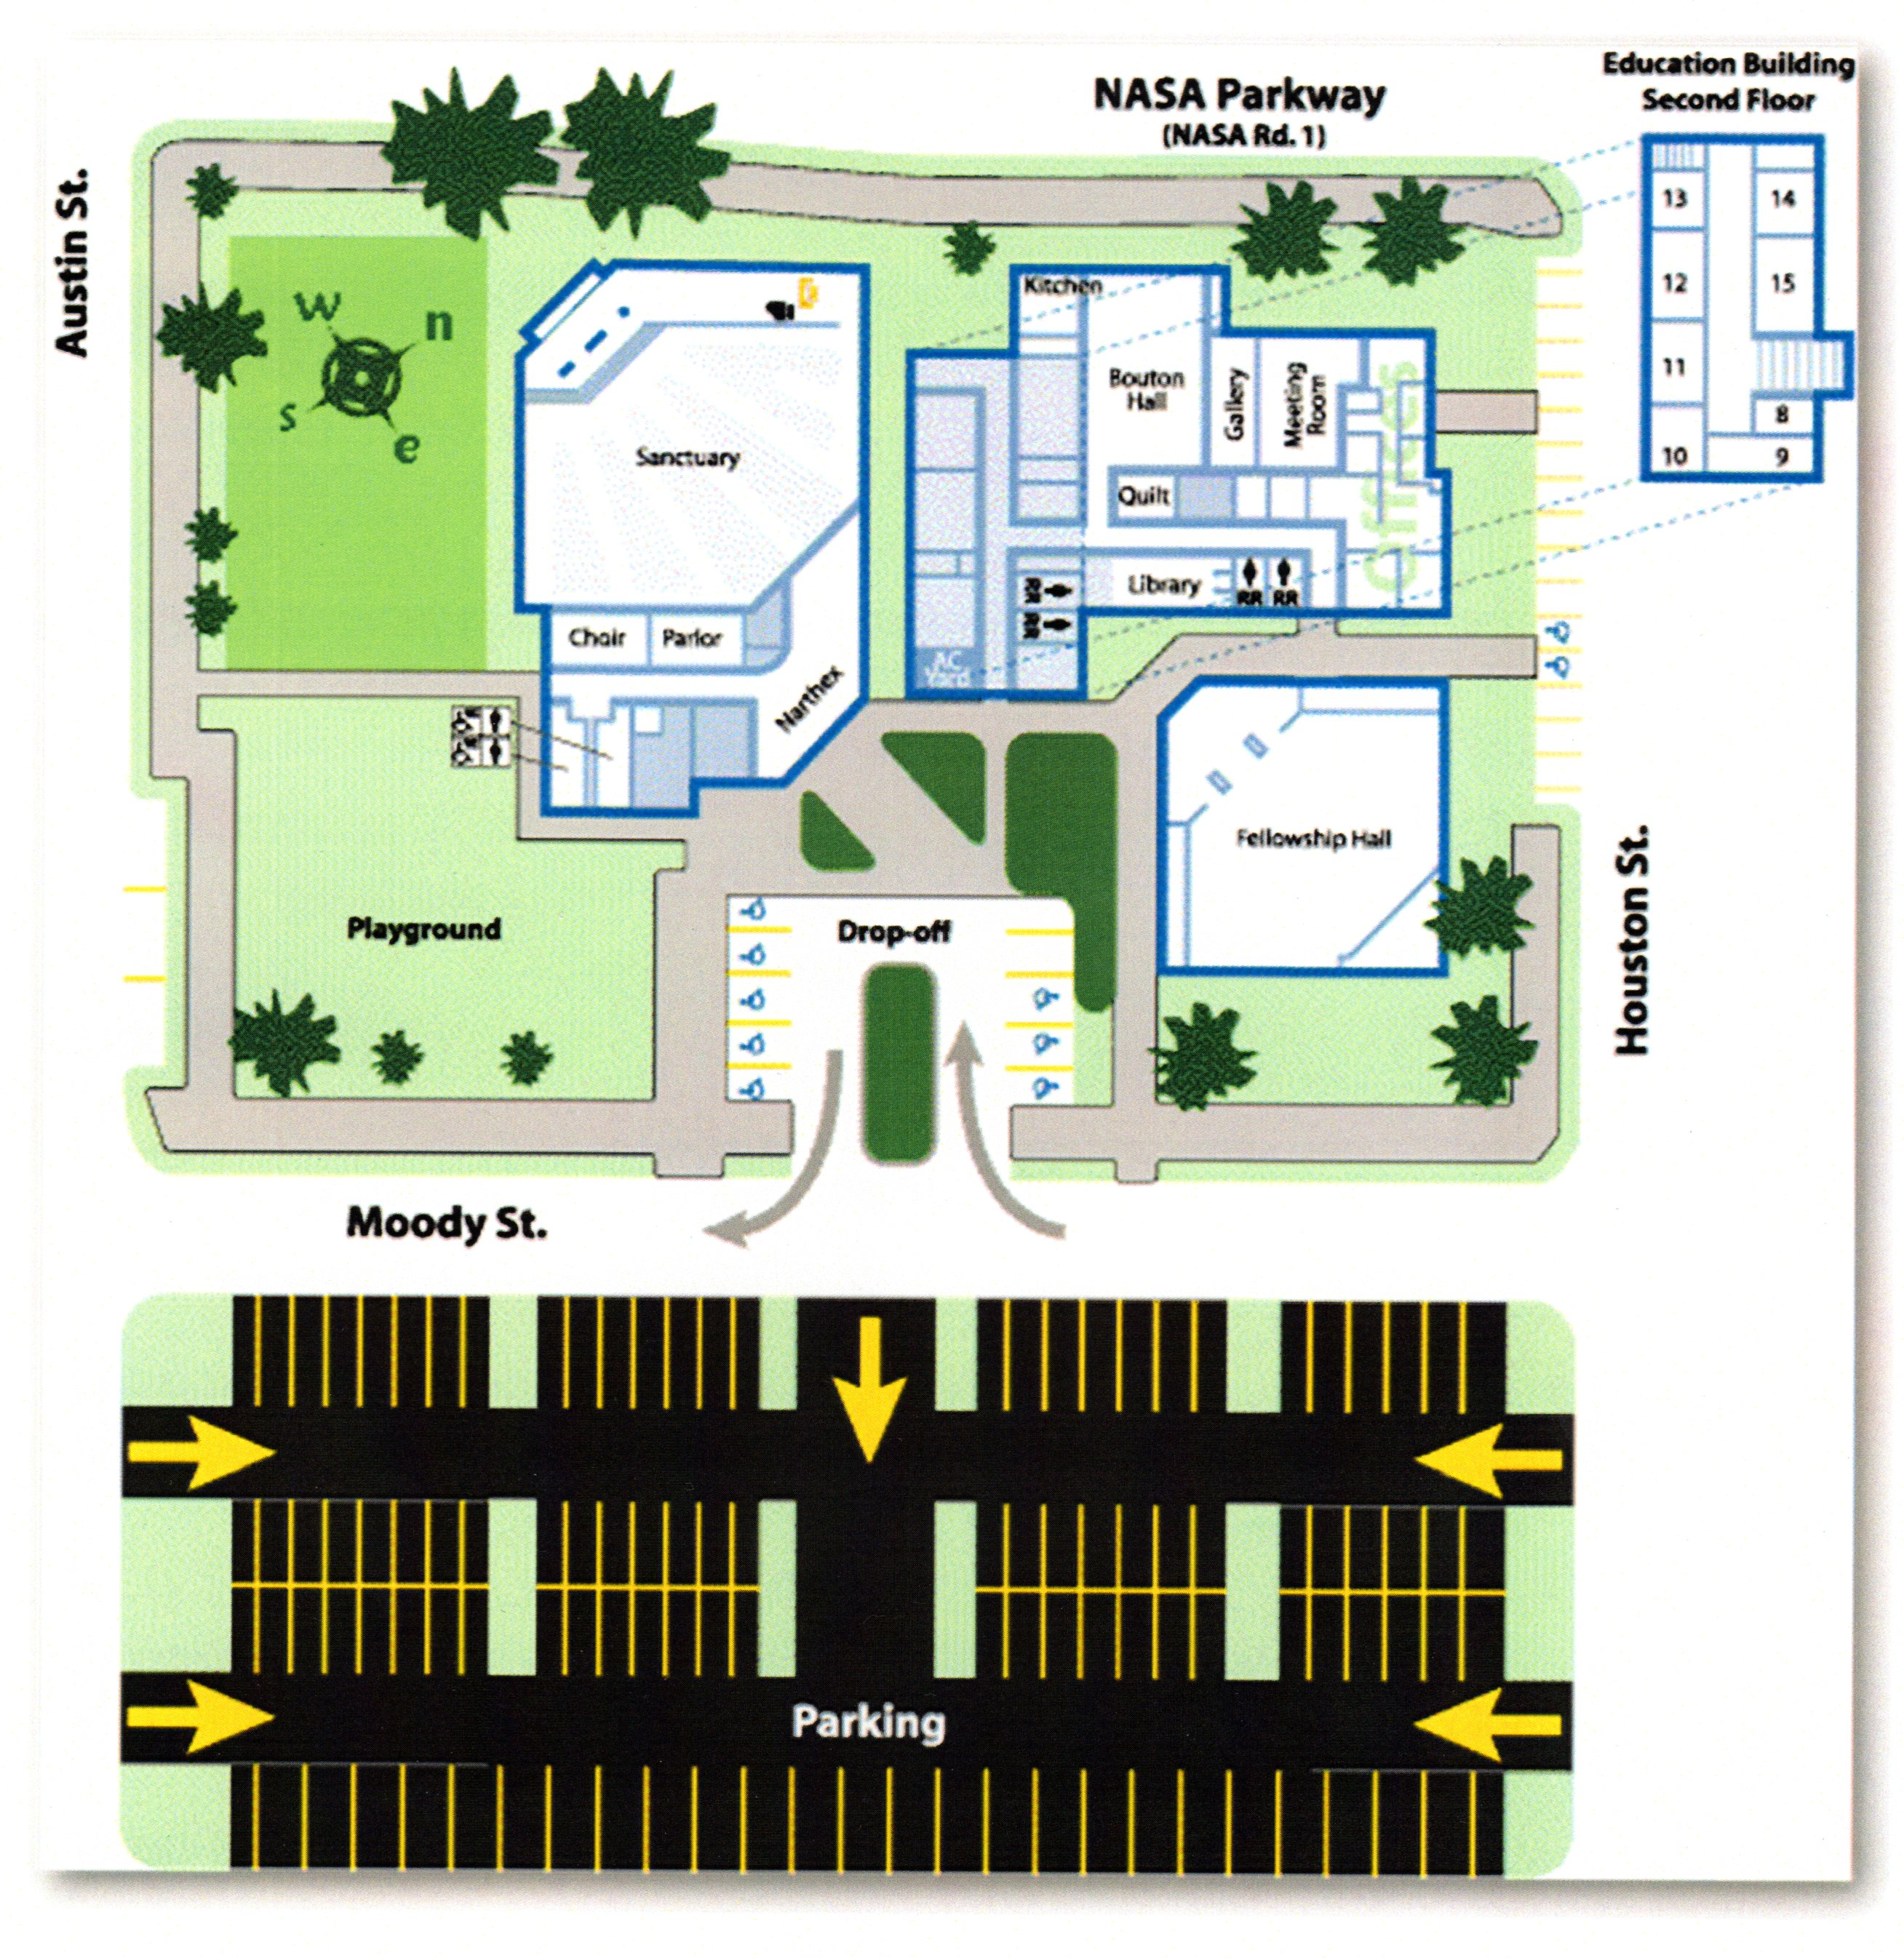
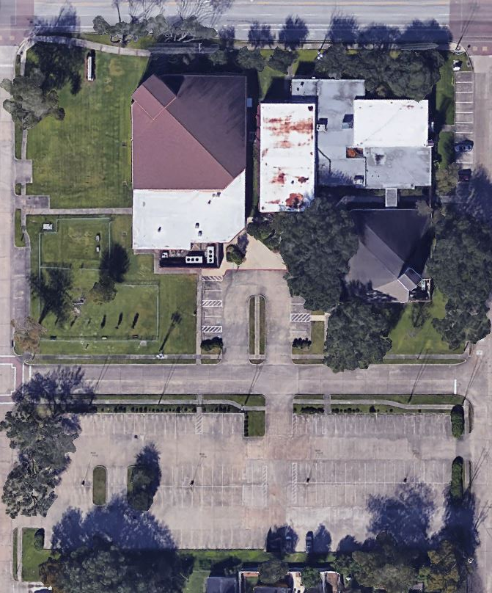
2016 Campus Overhead View and Map
Return to presentation
Return to Additional Details

Slide 19
City of Webster Campus Plat Map
Return to presentation
Return to Additional Details

Slide 20
Campus 2016 Real Estate Value
Real Estate Market Analysis Proposal
Current value of WPC property
$2,900,000 to $3,200,000
Rick Wade
Commercial Real Estate Broker
REMAX Space Center
Return to Additional Details

Slide 21
Current Debt as of January 1, 2017
Current (1/1/2017) building loan: ~$360,100. A $25,000 payment will be made in January. The final payment of the current loan is due on August 12, 2020, with a balloon payment of $365,334.59. Any remaining balance will be refinanced at rates at that time. Current projections have this debt paid off by June, 2025.
Current (1/1/2017) roof repair loans: ~$16,100. (Originally in 2015 WPC browed $43.1K: $21K from Amegy Bank, $15K from Presbytery, and $7.1K from WPC Endowment.)
Total debt as of January 1, 2017, is $376,200.
Return to presentation
Return to Additional Details

Slide 22
Lorrie Foreman
Assessment of WPC Campus
Lorrie Foreman, CEO of Venturi Outcomes and a general contractor specializing in nonprofit projects, provided the following assessment:
You have a wonderful campus, the bones are sound, but it needs maintenance and upkeep
The kitchen is a real asset
Her top three improvement suggestions are:
  Update the first floor of the CE Building
  Install a covered walk way between the Sanctuary and the CE Building
  Add attractive landscaping on the south side of the drop off area
Sound recording of the conversation with Lorrie Foreman are available in the Church Office.
Return to What we did
Return to Additional Details

Slide 23
2017 Summary of Campus Status
These six slides provide a summary of the campus and contain:
  Brief summary of
    Sanctuary
    Fellowship Hall
    Administration and CE Building Complex
    Grounds and Parking
  List of the key projects associated with that area of the campus
Projects in these slides cover the “DO NOW” and “Do Soon” projects and a sample of maintenance and improvement projects
Additional details are available in the “List of Projects” and the Commercial Building Inspector reports
Return to presentation
Return to Additional Details

Slide 24
2017 Campus Status - Sanctuary
Sanctuary was dedicated in 2004. It has water leaks at several locations (root cause of some not known). The Sanctuary needs HVAC system replacement, gutter and fascia repair, lighting improvements, AV upgrade, and maintenance or replacement of the Organ.
Key Sanctuary Projects
Project Name {Project Sheet Name} | Mission Impacted | Est Cost | Importance {DO NOW, Do Soon, Maintenance, Improvement} | Notes
Gutter and Flashing | Welcome | $1,500 | DO NOW | Water Leak
Seal stucco on sanctuary | Welcome | $40,000 | DO NOW | Water Leak
Flooding in sanctuary | Welcome & CE | TBD | DO NOW | Water Leak, Needs an inspection by a professional foundation inspector; water damage in Sanctuary
Leak in narthex over entry to Sanctuary | Welcome & Worship | TBD | DO NOW | Water Leak, previous repairs have not succeeded
Replace Roof | Welcome | $62,000 | Do Soon | Potential for Water Leak
Organ | Worship | $136,900 | Maintenance (Session Decision) | 3 options to repair/replace the organ
Replace sanctuary mechanical door | Worship | $2,400 | Do Soon
Improve Lighting in Sanctuary | Worship | $6,750 | Do Soon | Esp. the lights over the Bell Choir Area
Replace HVAC system | Worship | $52,000 | Maintenance | See Energy Audit
Walkway Cover from Sanctuary to CE Wing | Worship & CE | $26,000 | Improvement
Return to presentation
Return to Additional Details

Slide 25
2017 Campus Status – Fellowship Hall
Fellowship Hall was built in 1983 as a Sanctuary and was remodeled in 2004. It has some water damage in the east wall, needs a new roof, some windows are cracked, and the lintels need repair or replacement. It is a candidate for adding a full kitchen and bathrooms with shower facilities.
Key Fellowship Hall Projects
Project Name {Project Sheet Name} | Mission Impacted | Est Cost | Importance {DO NOW, Do Soon, Maintenance, Improvement} | Notes
Re-roofing Fellowship Hall | Fellowship | $36,000 | DO NOW | Water Leak
Repair stucco facade on Fellowship Hall | Fellowship | $20,000 | DO NOW | Water Leak
Replace foyer windows in Fellowship Hall | Fellowship | $36,000 | DO NOW | Water Leak
Repair Iron Gate going to A/C units | Fellowship | $1,200 | Maintenance
Replace Doors | Fellowship | $3,000 | Maintenance
Expand Fellowship Hall | Fellowship | $480,000 | Improvement | Add Kitchen and Bathrooms
Return to presentation
Return to Additional Details

Slide 26
2017 Campus Status – Admin & CE Building
Bouton Hall & Kitchen was built in 1974. It has water leaks either from the roof (recently repaired) or from condensation from the AC ducts. The drop down ceiling needs repair and painting. The windows need repair and insulation and lighting needs replacement.
CE Building was built in 1966 along with Bassett Parlor and the adjoining hallway. Its roof was repaired in 2015, but the interior down spouts were not inspected or repaired. The CE building needs HVAC replacement, insulation, repair of the exterior windows and doors, and lighting improvements. The CE bathroom needs to be upgraded. The building should be brought up to ADA compliance.
  Bassett Parlor AC needs replacement
Administrative Wing was built in 1960 as a Sanctuary and remodeled as offices and classrooms around 1983. It has water leaks either from the roof (recently repaired) or from condensation from the AC ducts. The stained-glass windows need repair and insulation, the drop down ceiling needs repair and painting, the windows of the southeast side offices leak and require repair, and the lighting needs replacement. The bathrooms need to be upgraded.
Return to presentation
Return to Additional Details

Slide 27
2017 Campus Status – Admin & CE Building
Key Admin and CE Projects
Project Name {Project Sheet Name} | Mission Impacted | Est Cost | Importance {DO NOW, Do Soon, Maintenance, Improvement} | Notes
Lighting in Admin and Education Building | CE & Welcome | $23,517 | DO NOW | Dark hallways are a major impediment to a welcoming environment
Bricks missing wall open | CE | $2,400 | DO NOW | Water Leak
Seal stucco on Education and Administration Building | CE | $5,000 | DO NOW | Water Leak
Seal Window Frames on Education and Administration Building | CE | $1,400 | DO NOW | Water Leak
Replace or repair leaking in windows in Helen and treasurer office | Admin | $1,000 | DO NOW | Water Leak
Replace tall stained glass windows on Education and Administration Building | CE | $7,200 | DO NOW | Water Leak
Fix old iron drain pipes that don’t drain on Education and Admin Building | CE | $4,000 | DO NOW | Water Leak
Replace Windows in CE hall facing NASA Parkway | CE | $4,500 | DO NOW | Water Leak
Fix whatever is causing the ceiling water spots in Education and Admin Buildings | CE & Admin | TDB | DO NOW | Water Leak, requires inspection to determine estimate
Replace HVAC in Administration and Education Building | CE & Admin | $24,000 | Do Soon | See Energy Audit
Renovate Administration wing | Admin | $433,100 | Improvement | Restructure offices, bathrooms etc.
Spruce up First Floor in Education and Administration Building | CE | $54,000 | Improvement
Change out the interior doors in the CE Wing | CE | $20,000 | Improvement
Return to presentation
Return to Additional Details

Slide 28
2017 Campus Status – Grounds and Parking
Drop-off Parking area needs repair of the lighting and is a candidate for a covered walkway to connect the buildings and protect people from rain when dropped off, and it could use some improved landscaping.
Main Parking Lot needs repair of the lights and of the dumpster.
The NASA Parkway side of the campus is a candidate for improved landscaping that is visually appealing and low maintenance.
Key Property Projects
Project Name {Project Sheet Name} | Mission Impacted | Est Cost | Importance {Do NOW, Do Soon, Maintenance, Improvement} | Notes
Exterior Lights | Welcoming | $9,582 | DO NOW; Safety | Done as of Dec 2016
Move and Repair Dumpster | Welcoming | $5,000 | Maintenance
Landscaping around Drop off Parking | Welcoming | TBD | Improvement | TBD
Return to Additional Details

Slide 29
Best Practices for the Campus Management Budget
Best practices for churches:
Annual Maintenance Budget should meet all three of these criteria:
  Should be 10% to 15% of total budget
  Should be $3 to $5 per building square foot total
  Should be 2% to 4% of the buildings replacement value
The Annual Maintenance Budget includes: Insurance, Utilities, Cleaning Services, Property Maintenance, Grounds Maintenance, and Custodial Contractors
From: churchadminpro.com, a web page that is "Equipping Church Administrators through strategic helps, resources, and consulting,“ at this location: Easy maintenance cost projection statistics - churchadminpro.com
Return to Recommendations
Return to Additional Details

Slide 30
WPC CM Budget vs. Criteria
WPC CM budget includes office equipment but not insurance
WPC CM budget does not address “DO NOW” or “Do Soon” maintenance
The Annual Maintenance Budget Criteria includes: Insurance, Utilities, Cleaning Services, Property Maintenance, Grounds Maintenance, and Custodial Contractors
Return to Recommendations
Return to Additional Details

Slide 31
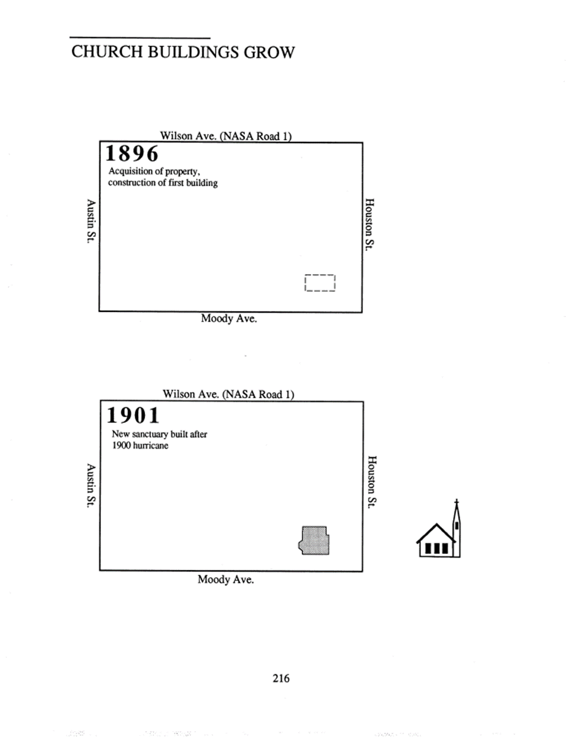
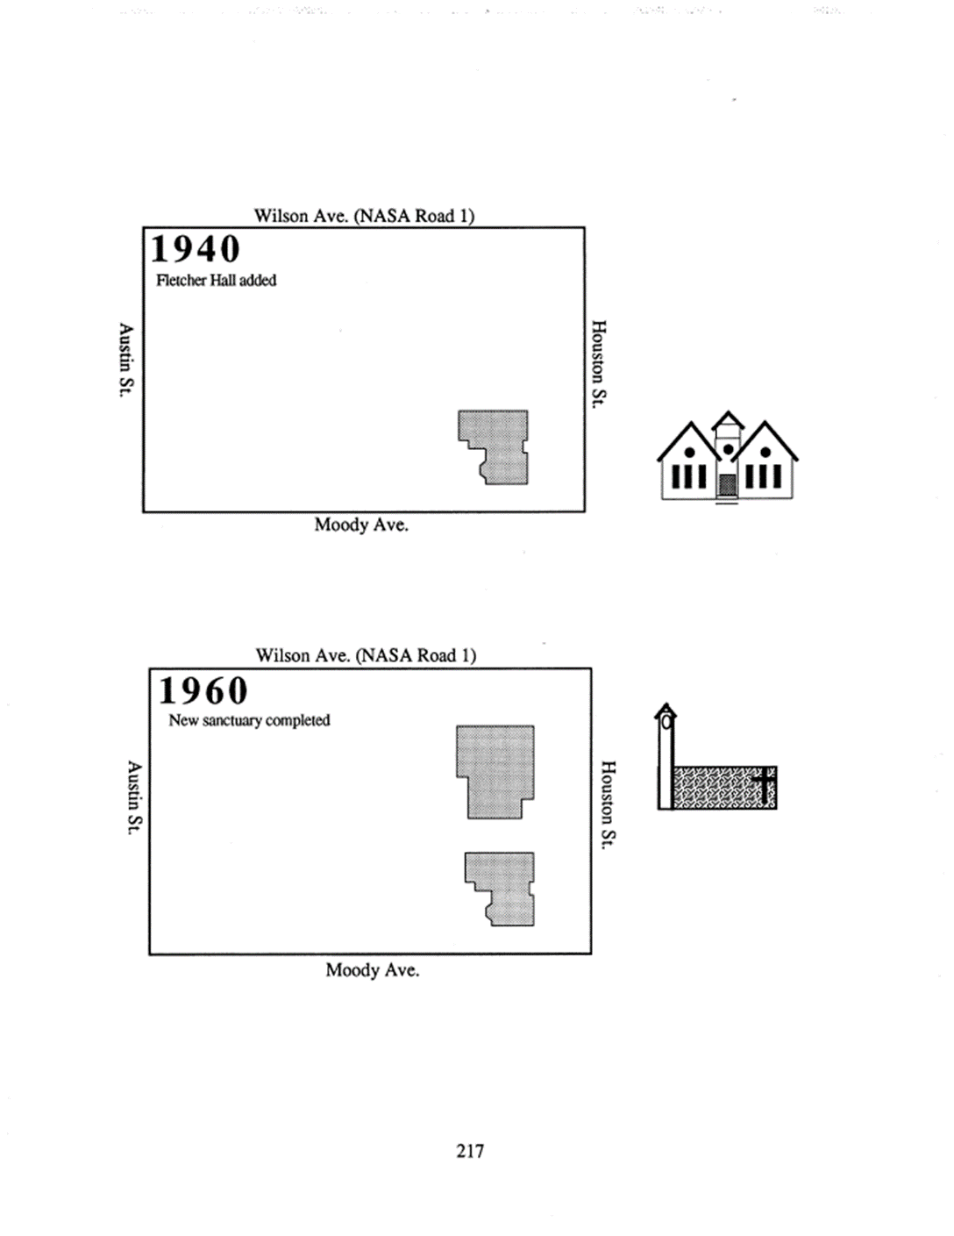

Early Campus History 1893 to 1990
"Little White Church on NASA Road One“ (1993) and NASA Projects
1893 founded
1900 hurricane
NASA established (58)
Project Mercury (58-63)
Oil discovered (1901)
Petrochemical Industry Growth (1960)
9 Oil Refineries along ship Channel (1930)
JSC Established (1961)
John Glenn
Return to what CPTF did
Return to Additional Details

Slide 32
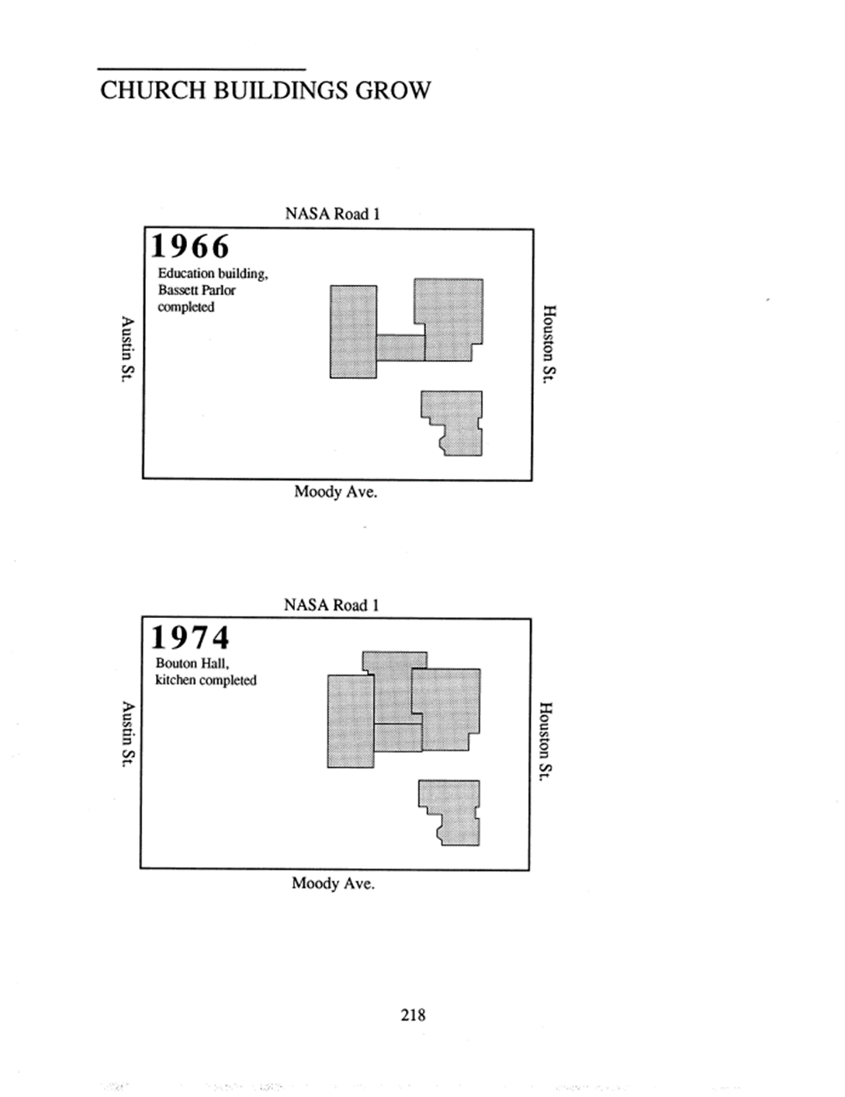
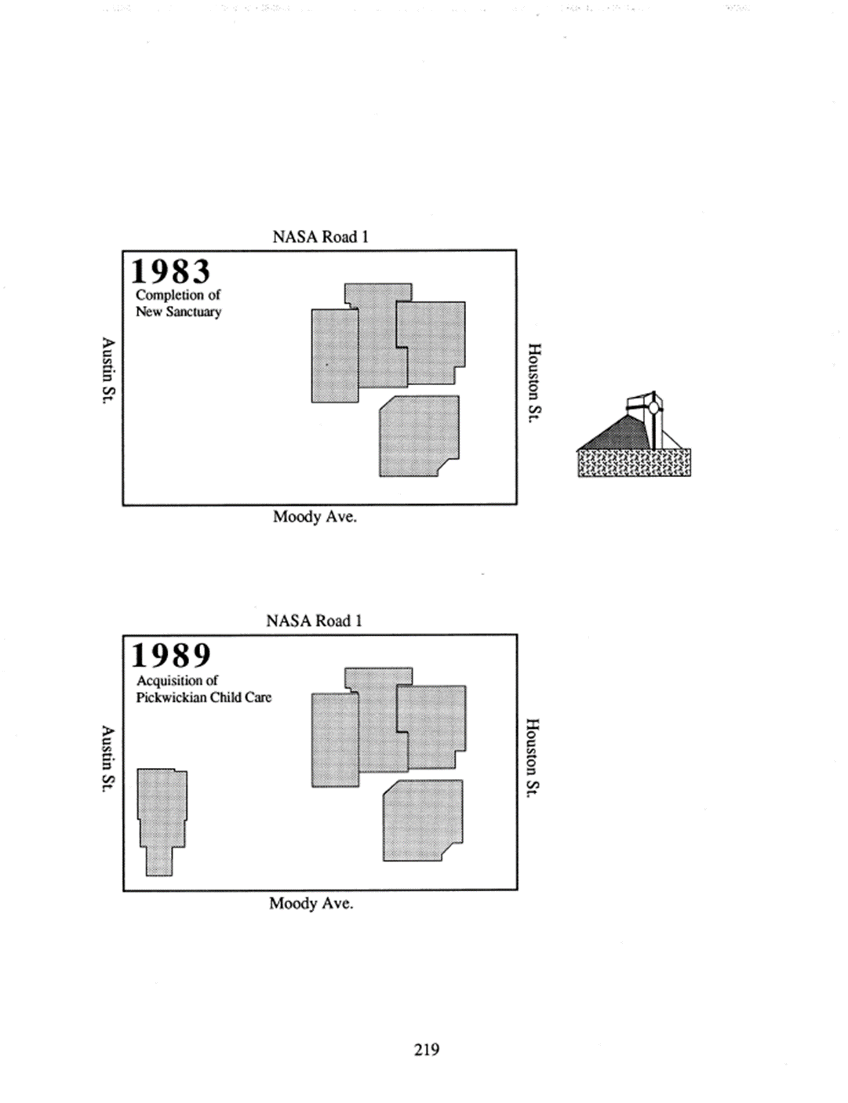
Early Campus History 1893 to 1990
"Little White Church on NASA Road One“ (1993) and NASA Projects
Gemini Program (61-66)
Apollo Program (61-72)
Space Shuttle Program (72-2011)
STS-1 (4/81)
Buzz Aldrin
7/20/1969
Lunar Communion
Skylab (66-79)
Jerry Carr
International Space Station (84-Present)
ISS First Segment (11/98)
Oil Companies Move Hq to Houston (1970s)
Return to what CPTF did
Return to Additional Details

Slide 33
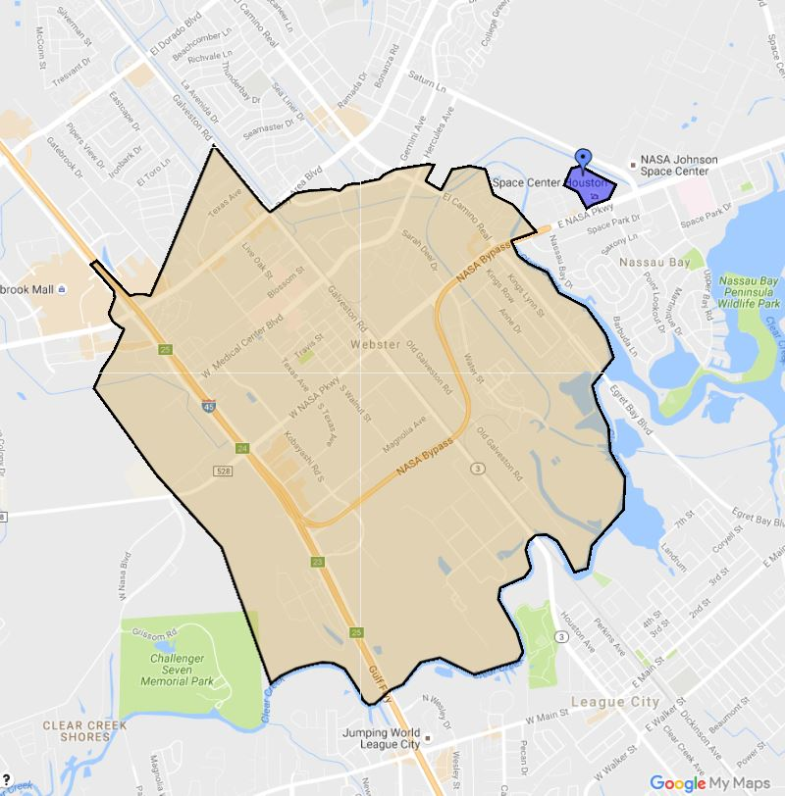

Where WPC is Located
City of Webster
( From City of Webster website)
WPC
The City of Webster is the Nucleus of Bay Area Houston with its strategic position midway between Galveston and downtown Houston.
Webster’s central corridors consist of Interstate 45 with 250,000 vehicles daily, Bay Area Boulevard with 100,000 vehicles per day, and NASA Parkway with 75,000 vehicles daily! Additionally, Medical Center Boulevard, Texas Avenue, and Highway 3 are arteries that accommodate the “medical center of the south,” with a service area population of 1,800,000 patients annually.
Webster's infrastructure development, high bond rating, and expanding local economy with a strong sales tax per capita -- nearly five times the national average -- illustrates that Webster's market is ideal and a leader among cities.
Webster is known as the retail, dining, and entertainment capital of Bay Area Houston. With rooftops driving retail, the population is 3,384,000 within a 30-mile radius, 999,000 within a 15- mile radius, and 589,000 within a 10-mile radius.
Additionally, Webster is supported by major industry sectors: medical, aerospace, retail, higher education, specialty chemical, tourism, entertainment, and biomedical.
Return to presentation
Return to Additional Details

Slide 34
City of Webster Demographics
From Wikipedia
As of the census^{[1]} of 2000, there were 9,083 people, 4,114 households, and 1,970 families residing in the city. The population density was 1,372.9 people per square mile (529.8/km²). There were 4,733 housing units at an average density of 715.4 per square mile (276.0/km²). The racial makeup of the city was 64.85% White, 9.03% African American, 0.55% Native American, 5.72% Asian, 0.15% Pacific Islander, 15.78% from other races, and 3.92% from two or more races. Hispanic or Latino of any race were 27.24% of the population.
There were 4,114 households out of which 24.6% had children under the age of 18 living with them, 32.7% were married couples living together, 10.1% had a female householder with no husband present, and 52.1% were non-families. 40.6% of all households were made up of individuals and 2.1% had someone living alone who was 65 years of age or older. The average household size was 2.14 and the average family size was 2.97.
In the city the population was spread out with 20.9% under the age of 18, 15.0% from 18 to 24, 43.5% from 25 to 44, 15.4% from 45 to 64, and 5.1% who were 65 years of age or older. The median age was 29 years. For every 100 females there were 109.3 males. For every 100 females age 18 and over, there were 107.3 males.
The median income for a household in the city was $42,385, and the median income for a family was $43,495. Males had a median income of $35,346 versus $29,808 for females. The per capita income for the city was $21,964. About 12.5% of families and 13.2% of the population were below the poverty line, including 19.2% of those under age 18 and 5.6% of those age 65 or over.
Return to presentation
Return to Additional Details

Slide 35
Community Demographics from PC (USA)
9.5 mile area surrounding WPC
This band includes League City, Clear Lake, Friendswood, and the towns from JSC to the Galveston Bay.
In the circle from 2 milers to 9.5 miles, the population is mostly married but there is a significate population of singles. The household income to typically more than $93K. The population is mostly White but there is a significant Hispanic population. Most are English speakers, but a significant group is non-English speakers. The growth in this band is mostly in League City and West of I45. About 45% have at least a bachelor's degree.
WPC
2 mile area surrounding WPC
This area is inside the City of Webster
In the two miles surrounding WPC, the population is characterized by mostly young families with an income from $45K to $70K; they are mostly White but there is a significant Hispanic population and about 25% are non-English speakers. About 20% have at least a bachelor's degree.
Return to presentation
Return to Additional Details

Slide 36
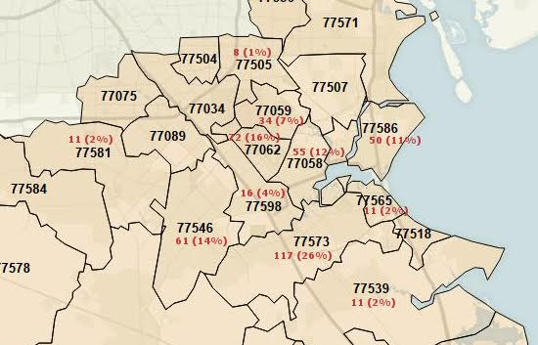
Where do our Members live by ZIP Code
~10 mile area surrounding WPC
WPC
Return to presentation
Return to Additional Details

Slide 37
Summary of July 2000 Master Plan-1A
Comprehensive Long-Range Master Plan, July 2000, Bay Architects
Completed parts are highlighted in light green
Phase ONE
  Demolish
    As needed
  Phase ONE A
    Maintenance and repair of existing administration building.
    Build new sanctuary at the comer of Nasa Road 1 and Austin.
      Five adult classrooms (that open up to sanctuary when needed).
      Narthex (to be expanded in phase Ill)
      New restrooms near sanctuary.
      Storage, Sound control room, Mechanical mezzanine.
      Covered walkway from northeast comer of Worship Center to existing two story building.
    Increase parking
      (Details deleted)
Return to presentation
Return to Additional Details

Slide 38
Summary of July 2000 Master Plan-1B
Comprehensive Long-Range Master Plan, July 2000, Bay Architects
Phase ONE B
  Convert existing sanctuary into multipurpose facility.
  Level floor.
  297 seating capacity for existing structure (at 15 square feet/person).
  Add 2358 square feet to southeast side of existing structure to increase seating capacity to 454.
  Addition to incorporate movable partitions for classroom options
  Add a new kitchen
  Add restrooms and mechanical
Return to presentation
Return to Additional Details

Slide 39
Summary of July 2000 Master Plan-2
Comprehensive Long-Range Master Plan, July 2000, Bay Architects
Phase TWO
  CONSTRUCT
  New two story education facility.
    First floor (10,493 square feet) used during the week for child care center and church programs and on Sundays for nursery and preliminary Sunday school. A 400 square foot kitchen, laundry, and elevator to the second floor are included in this square footage.
    Second floor (10,493 square feet) used for elementary and secondary Sunday school. Teacher workroom, library/computer resources, and mechanical are also located upstairs.
  Play yard to be fenced in for controlled access: 6433 square feet for occupancy of 80 children at a time.
  Narthex to be extended to southwest side of sanctuary enclosing corridor between sanctuary and new education facility.
  Covered walkway to be built from southwest side sanctuary
Return to presentation
Return to Additional Details

Slide 40
Summary of July 2000 Master Plan-3
Comprehensive Long-Range Master Plan, July 2000, Bay Architects
Phase THREE
  DEMOLISH
    Original two story education facility (8700 square feet), Bouton Hall, and kitchen serving Bouton Hall (2600 square feet).
  CONSTRUCT
    New administration wing and Narthex extension (4583 square feet) to connect sanctuary and original administration building.
    New multipurpose room (1409 square feet) to replace Bouton Hall. This room could be subdivided with movable partitions for youth activities.
    Renovate original administration building. Existing administration to be converted to adult classrooms. Existing choir to be expanded to include instrument storage, bell choir rehearsal, music storage, children choir practice room, and choir director office. Existing library to be converted into a conference room.
    Covered walkway to be added to the northwest side extending from the north comer of the original church building to the doors that service the sanctuary.
Return to presentation
Return to Additional Details

Slide 41
Summary of July 2000 Master Plan-4 and Future
Comprehensive Long-Range Master Plan, July 2000, Bay Architects
Phase FOUR
  DEMOLISH
    Parking lot on north side of Moody street
  CONSTRUCT
    New courtyard with covered and uncovered walkways, benches, and landscaping.
    Circular drive for passenger drop off.
FUTURE PHASES
  There has been some discussion on Future Phases that extend beyond Phase 4. These have been expressed as visions for the future growth of Webster Presbyterian Church after the initial phases are completed. Below is a list of possibilities for future growth.
    Demolition of Existing Administration Wing (original Sanctuary building) and replace with new Adult Classroom space.
    Possible purchase of additional residential lots on Washington St. (complete ownership of Blocks 30 & 31)
    Additional parking.
    New Gymnasium Facility.
    Additional Fellowship or Multi-Purpose space.
Return to presentation
Return to Additional Details

Slide 42
A Capital Campaign is a
Window to the Church’s Soul
“A campaign is not just a set of steps that individuals take. It is really a function of the institution’s concept of where it’s heading, a reflection of the organization’s priorities, needs, and mission.”
- Julia Walker
Jumpstarting the Stalled Fundraising Campaign (2009)
Return to Recommendations
Return to Additional Details

Slide 43
Capital Campaign Considerations
Needs to be managed by those with marketing and people skills
Needs backing and participation of Pastors and church leadership
First Question: “What ministry will be enabled (or enhanced) if you proceed with this campaign?”
Needs to have a vision or a marketing story that people are willing to give toward
  The Capital Campaign Vision needs to paint a captivating picture of the new reality you hope to achieve with the campaign.
  The campaign needs to describe WHAT is to be done and WHY it this important to the ministry of the church
  Justification of a campaign focused on only debt reduction and building repair is a challenge, but can be done
Determine what is feasible for the church
  How much can the church expect to raise
  Who are the top potential donors and how much do you expect from them
If trying to raise an amount equal to or more than your annual budget, then the campaign would benefit from professional counsel
Return to Recommendations
Return to Additional Details

Slide 44
Experience of nearby PC (USA) churches with Capital Campaigns
Grand Lakes PC in Katy
Pastor – Dean Pogue - dpogue@grandlakespc.org
Church web - http://grandlakespc.org/
When I talked to him he started by asking about our vision for the fundraiser and then if we had a master plan we were following. I guess that if we did not have these he would have told us to go do that first.
Then he described their situation. When he arrived, he noticed a lot of “dark” rooms and challenged the church to focus on and increase the “ministry per sq. ft. per hr.” (Did I mention that he has a geology degree and an MS in corporate finance, and spent his pre ministry career doing business consulting)
He said they considered 3 Capital Campaign consulting firms
  Cargill Associates at http://www.cargillassociates.com
  Generis at https://generis.com
  Horizons Stewardship Company http://www.horizonsstewardship.com/
They chose Horizons because they insisted on starting with prayer and made prayer key a part of their process. Pastor Dean said “We engaged a campaign consultant, and it was worth every penny!”
Return to Recommendations
Return to Additional Details

Slide 45
Experience of nearby PC (USA) churches with Capital Campaigns
FPC, Tomball - small congregation pretty much ran their own campaign –
Pastor is Robert Rush - RobertRush832@gmail.com
Church web - http://www.fpctomball.org/
Tomball PCUSA church used Cargill Associates at http://www.cargillassociates.com to help with their fund raiser. There was a fee. Cargill provides training and materials, but much of the work is up to the church. Pastor Rush said they were very happy with the help received and they are now Building.
Covenant, College Station - similar size congregation - ran a "bond" campaign of their own creating –
Pastor - Jonathan Murray - jonathan@covenantpresbyterian.org
Church web - http://www.covenantpresbyterian.org/
Monday I talked to Pastor Jonathon Murray. He gave me the name of a member who is a lawyer who managed their campaign. Basically they found a few members to lend the church money at low interest and thus moved debt from the bank to some members. They still have a bank debt, and overall the total debt was not reduced.
Return to Recommendations
Return to Additional Details

Slide 46
Experience of nearby PC (USA) churches with Capital Campaigns
St. Paul Presbyterian Church at http://saintpaulhouston.org/
A member started talking about their Capital Fund Raising -- which they are in the middle (end??) of. I had all sorts of questions for her. They used a group called Generis (at https://generis.com ) to lead their campaign and have been happy with them. They have a large population of people from other countries, and many of them send their money home to their families rather than give to the church.
They are having a little difficulty trying to educate them about supporting their church here. She told me that they have sold their property but are having trouble finding a place to build. I asked her if they got any help from the Presbytery on property value/cost of their building, or anything like that. The answer was no. They had a commercial realtor in their church who donated his time/services to handle all of that for them. They had multiple offers for their land which is on 59 near Ft. Bend area. So, they do have the money to build what they want.
They have decided on the architect that they want to use -- Charles Shaw with Church Build. He only works on churches. Although he lives near Baytown (?), his office is in Bellaire. When we were talking, she said that they had a big church. I asked how many people they had, and she said they had about 150.
Return to Recommendations
Return to Additional Details

